Slide 1

95
abc

Slide 2
Nucleophilic Substitution

Slide 3
Mechanisms for Nucleophilic Substitution
Nucleophilic Substitution:
Four most common charge types
The most common reactants are neutral halides or sulfonates
These compounds can react with either neutral or anionic nucleophiles.
When the nucleophile is the solvent, as in Entries 2 and 3, the reaction is called a solvolysis.
S_{N}1, substitution-nucleophilic-unimolecular
S_{N}2, substitution-nucleophilic-bimolecular

Slide 4
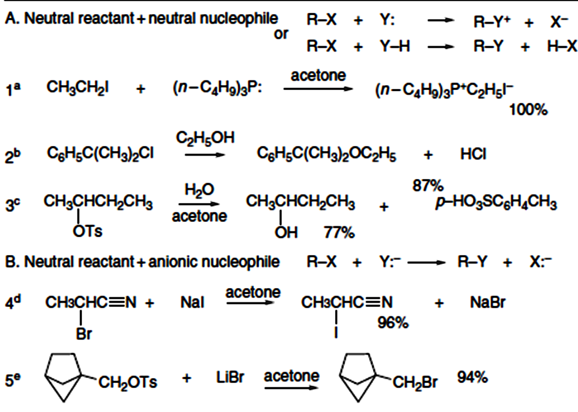
Scheme 4.1. Representative Nucleophilic Substitution Reactions

Slide 5
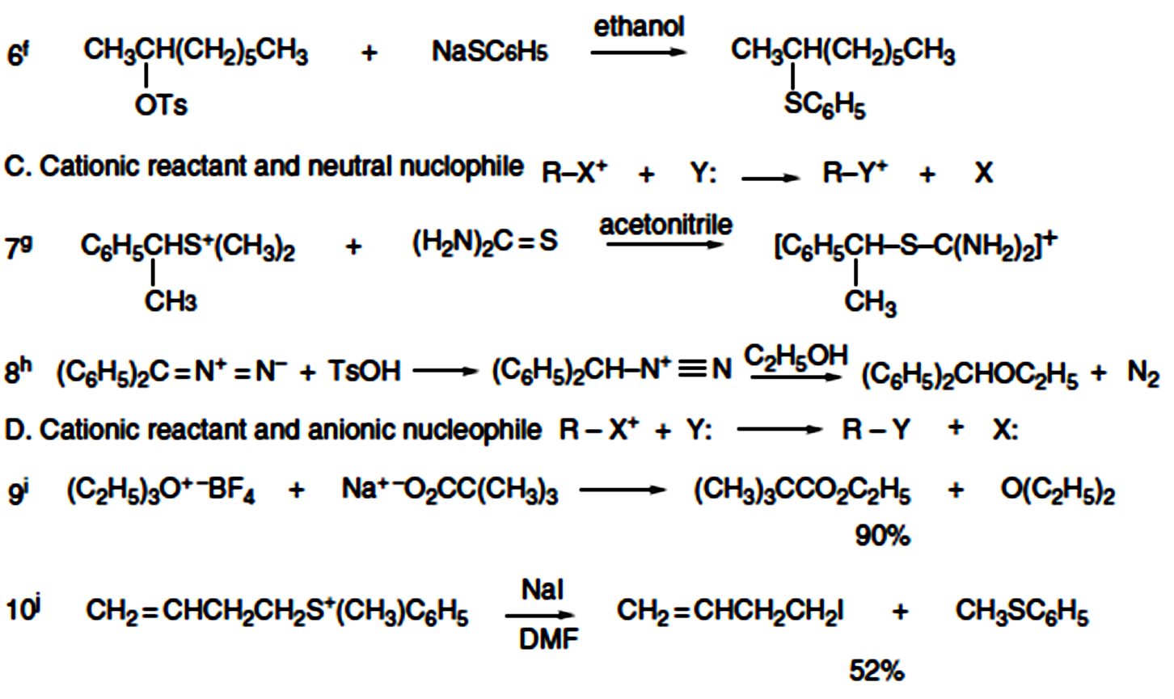

Slide 6
Substitution by the Ionization S_{N}1 Mechanism
Heterolytic dissociation of the reactant to a tricoordinate carbocation and the leaving group.
The ionization step is rate determining
Exhibits first-order kinetics
The rate of decomposition of the reactant being independent of the concentration and identityof the nucleophile.
Carbonium ions (Carbocation)
S_{N}1, for substitution, nucleophilic, unimolecular

Slide 7
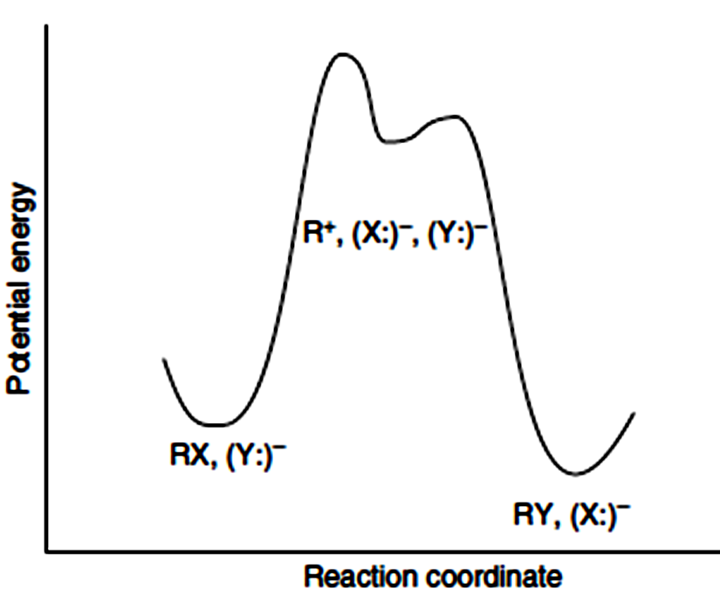
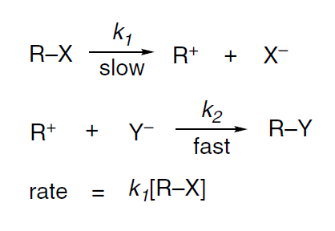
Fig. 4.1. Reaction energy profile for nucleophilic substitution by the ionization (S_{N} 1) mechanism.

Slide 8
As the rate-determining step is endothermic with a late TS, application of Hammond’s postulate indicates that the TS should resemble the product of the first step (the carbocation intermediate).
Ionization is facilitated by factors that lower the energy of the carbocation or raise the energy of the reactant.
The rate of ionization depends primarily on: (A) reactant structure, including the identity of the leaving group, and (B) the solvent’s ionizing power.
The most important electronic effects are: (1) stabilization of the carbocation by electron release, (2) the ability of the leaving group to accept the electron pair from the covalent bond that is broken, and (3) the capacity of the solvent to stabilize the charge separation that develops in the TS.

Slide 9
(4) Steric effects are also significant because of the change in coordination that occurs on ionization. The substituents are spread apart as ionization proceeds, so steric compression in the reactant favors ionization.
On the other hand, (5) geometrical constraints that preclude planarity of the carbocation are unfavorable and increase the energy required for ionization.
The ionization process is very sensitive to solvent effects, which are dependent on the charge type of the reactants.
Ionization of a neutral substrate results in charge separation, and solvent polarity has a greater effect at the TS than for the reactants.
Polar solvents lower the energy of the TS more than solvents of lower polarity.

Slide 10
In contrast, ionization of cationic substrates, such as trialkylsulfonium ions, leads to dispersal of charge in the TS and reaction rates are moderately retarded by more polar solvents because the reactants are more strongly solvated than the TS. These relationships are illustrated in Figure 4.2.
Stereochemical information can add detail to the mechanistic picture of the S_{N}1 substitution reaction.
The ionization step results in formation of a carbocation intermediate that is planar because of its SP² hybridization. If the carbocation is sufficiently long-lived under the reaction conditions to diffuse away from the leaving group, it becomes symmetrically solvated and gives racemic product.

Slide 11
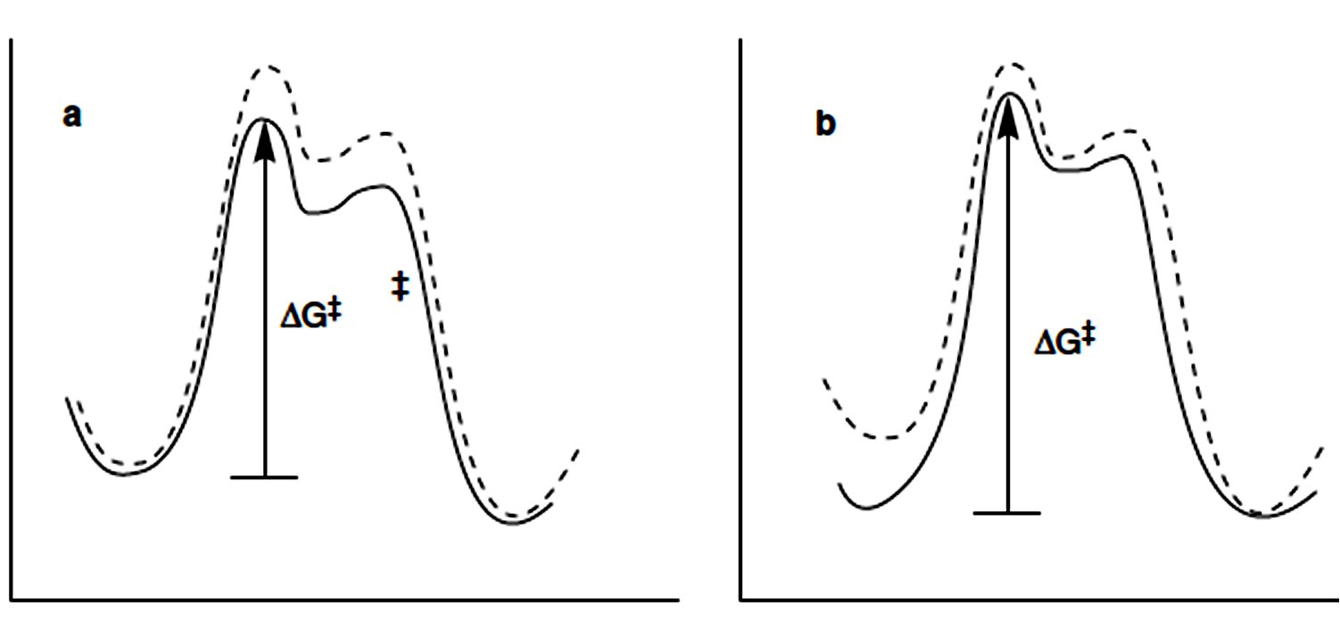
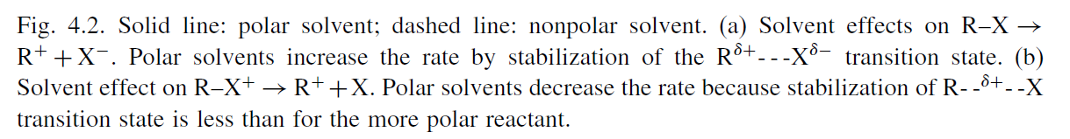

Slide 12
If this condition is not met, the solvation is dissymmetric and product can be obtained with net retention or inversion of configuration, even though an achiral carbocation is formed.
The extent of inversion or retention depends on the specific reaction. It is frequently observed that there is net inversion of configuration.
The stereochemistry can be interpreted in terms of three different stages of the ionization process.
1-The contact ion pair represents a very close association between the cation and anion formed in the ionization step.
2-The solvent-separated ion pair retains an association between the two ions, but with intervening solvent molecules.
3-Only at the dissociation stage are the ions independent and the carbocation symmetrically solvated. The tendency toward net inversion is believed to be due to electrostatic shielding of one face of the carbocation by the anion in the ion pair.

Slide 13
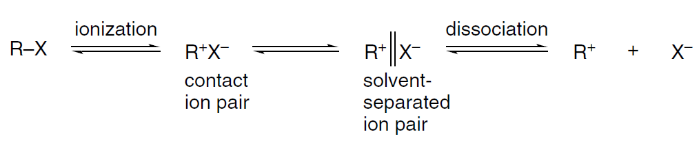

Slide 14
Substitution by the Direct Displacement S_{N}2 Mechanism
It is concerted.
The reactant is attacked by a nucleophile from the side opposite the leaving group.
The TS has trigonal bipyramidal geometry with a pentacoordinate carbon.
These reactions exhibit second-order kinetics
The mechanistic designation is S_{N}2 for substitution, nucleophilic, bimolecular.
A reaction energy diagram is given in Figure 4.3.
A symmetric diagram such as the one in the figure would correspond, for example, to exchange of iodide by an S_{N}2 mechanism.

Slide 15
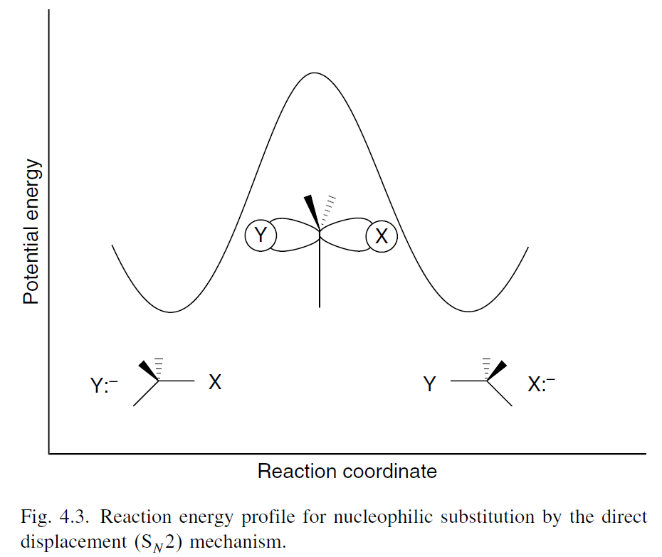
rate = k[R-X][Nu:]

Slide 16
The frontier orbitals in S_{N}2 are a filled nonbonding orbital on the nucleophile Y: and the σ∗ antibonding orbital associated with the carbon undergoing substitution with the leaving group X.
This antibonding orbital has a large lobe on carbon directed away from the C−X bond. Back-side approach by the nucleophile is favored because the strongest initial interaction is between the filled orbital on the nucleophile and the antibonding σ∗ orbital. As the transition state is approached, the orbital at the substitution site has p character.
The MO picture predicts that the reaction will proceed with inversion of configuration, because the development of the TS is accompanied by rehybridization of the carbon to the trigonal bipyramidal geometry. As the reaction proceeds on to product, sp3 hybridization is reestablished in the product with inversion of configuration.

Slide 18
Front-side approach is disfavored because the density of the σ∗ orbital is less in the region between the carbon and the leaving group and, as there is a nodal surface between the atoms, a front-side approach would involve both a bonding and an antibonding interaction with the σ∗ orbital.
The direct displacement S_{N}2 mechanism has both kinetic and stereochemical consequences. S_{N}2 reactions exhibit second-order kinetics—first order in both reactant and nucleophile.
Because the nucleophile is intimately involved in the rate-determining step, not only does the rate depend on its concentration, but the nature of the nucleophile is very important in determining the rate of the reaction.
This is in sharp contrast to the ionization mechanism, in which the identity and concentration of the nucleophile do not affect the rate of the reaction.

Slide 20
The rates of S_{N}2 reactions are very sensitive to the steric bulk of the substituents. The optimum reactant from a steric point of view is CH₃–X.
As in the case of the ionization mechanism, the better the leaving group is able to accommodate an electron pair, the faster the reaction. Leaving group ability is determined: primarily by the C−X bond strength and secondarily by the relative stability of the anion.
However, since the nucleophile assists in the departure of the leaving group, the leaving group effect on rate is less pronounced than in the ionization mechanism.

Slide 21
Two of the key observable characteristics of S_{N}1 and S_{N}2 mechanisms are kinetics and stereochemistry. Both kinds of observations have limits, however.
Many nucleophilic substitutions are carried out under conditions in which the nucleophile is present in large excess and the observed kinetics become pseudo first order (when the solvent is the nucleophile) (solvolysis).
In this case, the kinetics of the reaction provides no evidence as to whether the S_{N}1 or S_{N}2 mechanism is operating.

Slide 22
Stereochemistry also sometimes fails to provide a clear-cut distinction between the two limiting mechanisms.
Many substitutions proceed with partial inversion of configuration rather than the complete racemization or inversion implied by the limiting mechanisms.
Some reactions exhibit inversion of configuration, but other features of the reaction suggest that an ionization mechanism must operate.
Other systems exhibit “borderline” behavior that makes it difficult to distinguish between the ionization and direct displacement mechanism.
The reactants most likely to exhibit borderline behavior are secondary alkyl and primary and secondary benzylic systems.

Slide 23
Detailed Mechanistic Description and Borderline Mechanisms
The ionization and direct displacement mechanisms can be viewed as the limits of a mechanistic continuum. At the S_{N}1 limit, there is no covalent interaction between the reactant and the nucleophile in the TS for cleavage of the bond to the leaving group.
At the S_{N}2 limit, the bond-formation to the nucleophile is concerted with the bond breaking step. In between these two limiting cases lies the borderline area in which the degree of covalent interaction with the nucleophile is intermediate between the two limiting cases.
The concept of ion pairs was introduced by Saul Winstein, who proposed that there are two distinct types of ion pairs involved in substitution reactions.

Slide 24
The role of ion pairs is a crucial factor in detailed interpretation of nucleophilic substitution mechanisms. Winstein concluded that two intermediates preceding the dissociated carbocation were required to reconcile data on kinetics and stereochemistry of solvolysis reactions.
The process of ionization initially generates a carbocation and counter ion in immediate proximity to one another.
This species, called a contact ion pair (or intimate ion pair), can proceed to a solvent-separated ion pair in which one or more solvent molecules are inserted between the carbocation and leaving group, but in which the ions are kept together by the electrostatic attraction.
The “free carbocation,” characterized by symmetrical solvation, is formed by diffusion from the anion, a process known as dissociation.

Slide 25
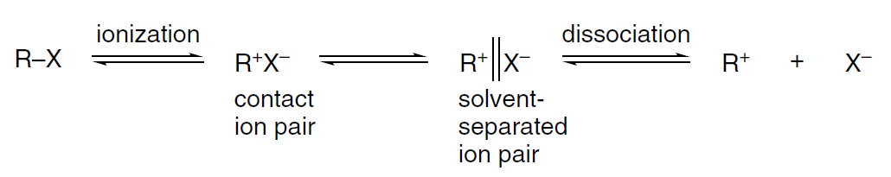

Slide 26
Attack by a nucleophile or the solvent can occur at each stage. Nucleophilic attack on the contact ion pair is expected to occur with inversion of configuration, since the leaving group will shield the front side of the carbocation.
At the solvent-separated ion pair stage, the nucleophile can approach from either face, particularly in the case where the solvent is the nucleophile. However, the anionic leaving group may shield the front side and favor attack by external nucleophiles from the back side.

Slide 27
Reactions through dissociated carbocations should occur with complete racemization.
According to this interpretation, the identity and stereochemistry of the reaction products are determined by the extent to which reaction with the nucleophile occurs on the un-ionized reactant, the contact ion pair, the solvent-separated ion pair, or the dissociated carbocation.
Many specific experiments support this general scheme. For example, in 80% aqueous acetone, the rate constant for racemization of p-chlorobenzhydryl p-nitrobenzoate and the rate of exchange of the ¹⁸O in the carbonyl oxygen can be compared. At 100 ºC, k_{ex}/k_{rac} = 2.3.

Slide 29
If it is assumed that ionization results in complete randomization of the ¹⁸O label in the carboxylate ion, k_{ex} is a measure of the rate of ionization with ion pair return and k_{rac} is a measure of the extent of racemization associated with ionization.
The fact that the rate of isotopic exchange exceeds that of racemization indicates that ion pair collapse occurs with predominant retention of configuration. This is called internal return. When a better nucleophile is added to the system (014M NaN₃), k_{ex} is found to be unchanged, but no racemization of reactant is observed.
Instead, the intermediate that can racemize is captured by azide ion and converted to substitution product with inversion of configuration. This must mean that the contact ion pair returns to the reactant more rapidly than it is captured by azide ion, whereas the solvent-separated ion pair is captured by azide ion faster than it returns to the racemic reactant.

Slide 30
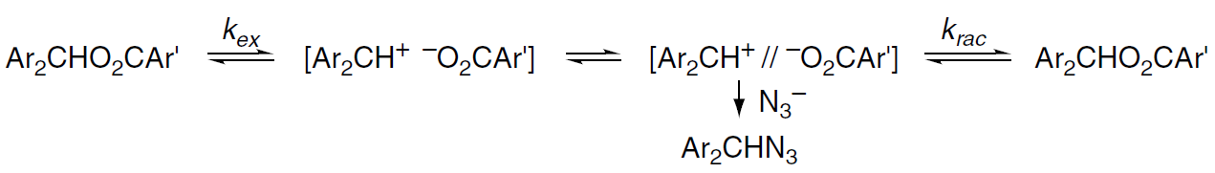

Slide 31
During solvolysis of isopropyl benzenesulfonate in trifluoroacetic acid (TFA), it has been found that exchange among the sulfonate oxygens occurs at about one-fifth the rate of solvolysis, which implies that about one-fifth of the ion pairs recombine rather than react with the nucleophile.
A similar experiment in acetic acid indicated about 75% internal return.

Slide 32
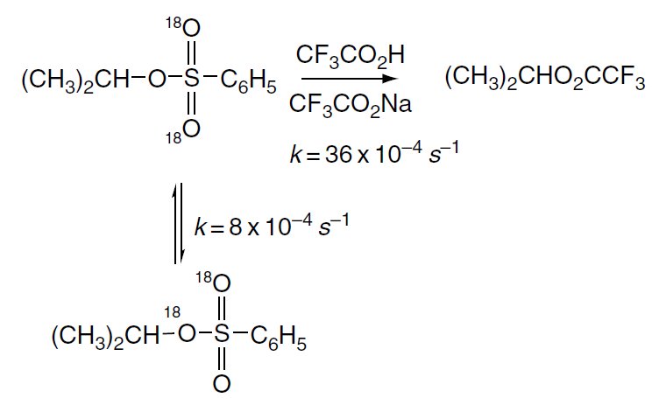

Slide 33
A study of the exchange reaction of benzyl tosylates during solvolysis in several solvents showed that with electron-releasing group (ERG) substituents, e.g., p-methylbenzyl tosylate, the degree of exchange is quite high, implying reversible formation of a primary benzyl carbocation.
For an electron-withdrawing group (EWG), such as m-Cl, the amount of exchange was negligible, indicating that reaction occurred only by displacement involving the solvent. When an EWG is present, the carbocation is too unstable to be formed by ionization.
This study also demonstrated that there was no exchange with added “external” tosylate anion, proving that isotopic exchange occurred only at the ion pair stage.

Slide 34
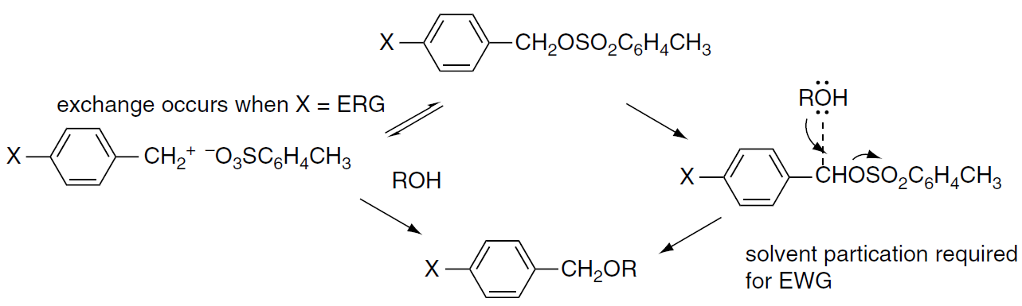

Slide 35
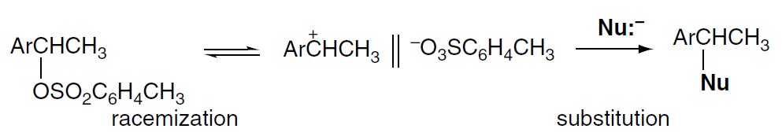
The ion pair return phenomenon can also be demonstrated by comparing the rate of racemization of reactant with the rate of product formation.
For a number of systems, including l-arylethyl tosylates, the rate of decrease of optical rotation is greater than the rate of product formation, which indicates the existence of an intermediate that can re-form racemic reactant. The solvent-separated ion pair is the most likely intermediate to play this role.

Slide 36
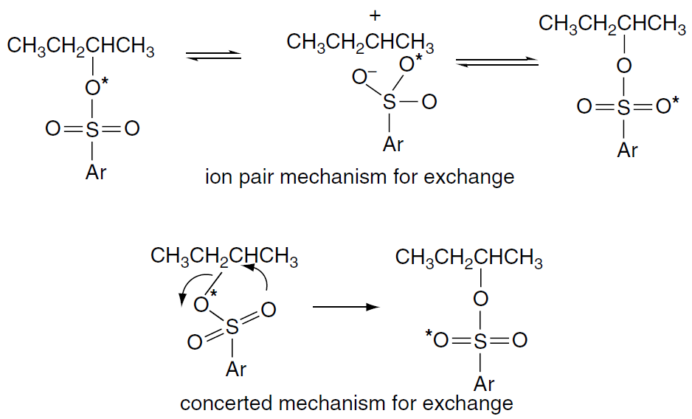
Racemization, however, does not always accompany isotopic scrambling. In the case of 2-butyl 4-bromobenzenesulfonate, isotopic scrambling occurs in trifluoroethanol solution without any racemization.
Isotopic scrambling probably involves a contact ion pair in which the sulfonate can rotate with respect to the carbocation without migrating to its other face. The unlikely alternative is a concerted mechanism, which avoids a carbocation intermediate but requires a front-side displacement.

Slide 37
The idea that ion pairs are key participants in nucleophilic substitution is widely accepted. The energy barriers separating the contact, solvent-separated, and dissociated ions are thought to be quite small.
The reaction energy profile in Figure 4.4 depicts the three ion pair species as being roughly equivalent in energy and separated by small barriers.
The gradation from S_{N}1 to S_{N}2 mechanisms can be summarized in terms of the shape of the potential energy diagrams for the reactions, as illustrated in Figure 4.5. Curves A and C represent the S_{N}1 and S_{N}2 limiting mechanisms.

Slide 38
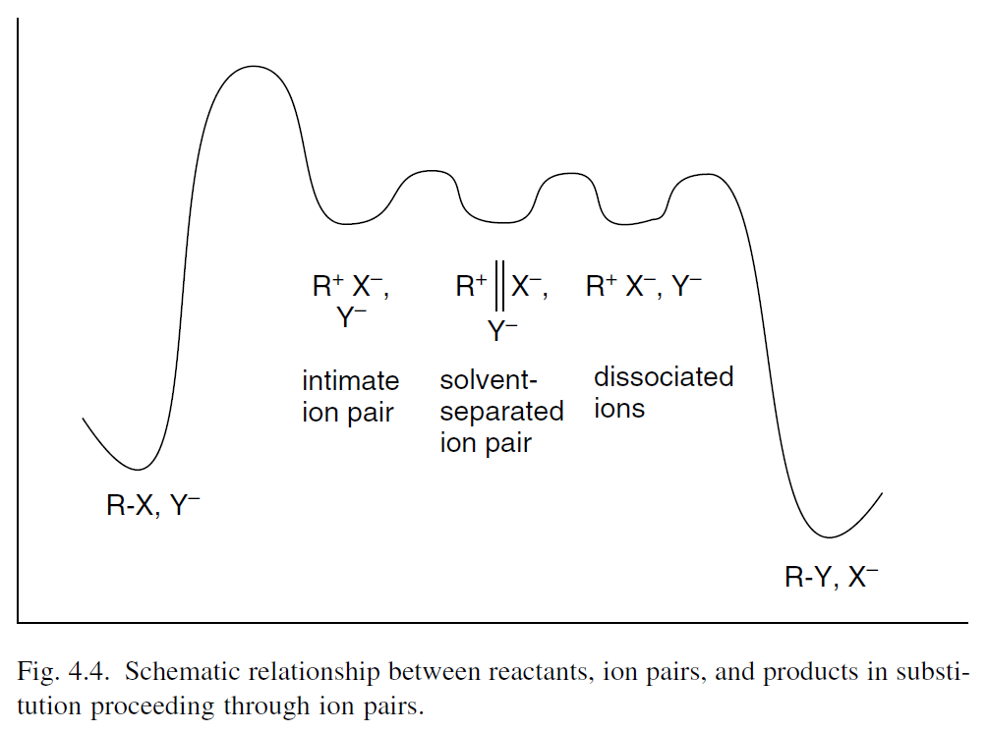

Slide 39
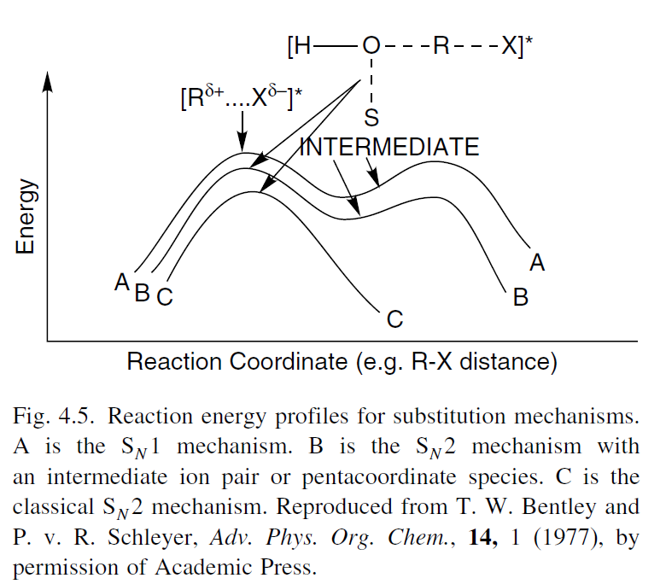

Slide 40
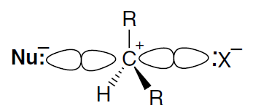
The gradation from the S_{N}1 to the S_{N}2 mechanism involves greater and greater nucleophilic participation by the solvent or nucleophile at the transition state.
An ion pair with strong nucleophilic participation represents a mechanistic variation between the S_{N}1 and S_{N}2 processes.
This mechanism is represented by curve B and designated S_{N}2 (intermediate). It pictures a carbocation-like TS, but one that nevertheless requires back-side nucleophilic participation and therefore exhibits second-order kinetics.

Slide 41
In the S_{N}1 (lim) mechanism, the carbocation intermediate has a significant lifetime and is equilibrated with solvent prior to capture by a nucleophile (Figure 4.6).
The reaction is clearly stepwise and the energy minimum in which the carbocation intermediate resides is evident. As the stability of the carbocation decreases, its lifetime becomes shorter. The barrier to capture by a nucleophile becomes less and eventually disappears. This is described as the “uncoupled” mechanism.

Slide 42
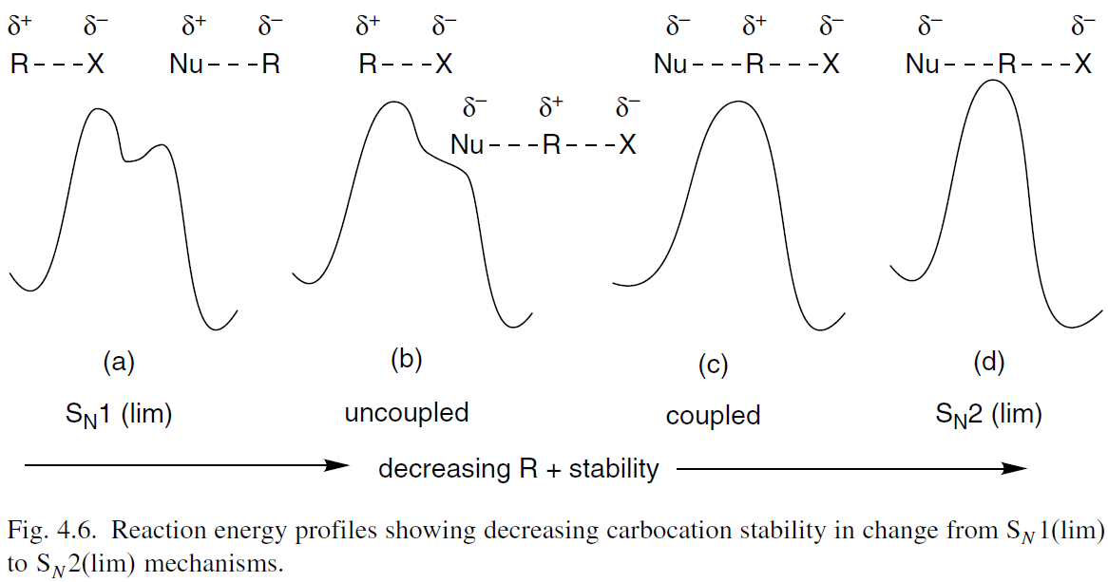

Slide 43
Ionization proceeds without nucleophilic participation but the carbocation does not exist as a free intermediate. Such reactions exhibit S_{N}1 kinetics, since there is no nucleophilic participation in the ionization.
At still lesser carbocation stability, the lifetime of the ion pair is so short that it always returns to the reactant unless a nucleophile is present to capture it as it is formed.
This type of reaction exhibits second-order kinetics, since the nucleophile must be present for reaction to occur. Jencks describes this as the “coupled” substitution process.

Slide 44
Finally, when the stability of the (potential) carbocation is so low that it cannot form, the direct displacement mechanism [S_{N}2(lim)] operates.
The continuum corresponds to decreasing carbocation character at the TS proceeding from S_{N}1 (lim)to S_{N}2 (lim) mechanisms.
The degree of positive charge decreases from a full positive charge at a S_{N}1 (lim) to the possibility of net negative charge on carbon at the S_{N}2 (lim).

Slide 45
Nucleophilicity usually decreases : H₂N⁻ > HO⁻ > F⁻ or C₆H₅S⁻ > Cl⁻ (The effect of electronegativity and polarizability).
Nucleophilicity increases : I⁻ > Br⁻ > Cl⁻ > F⁻ and C₆H₅Se⁻ > C₆H₅S⁻ > C₆H₅O⁻
Three factors affect this order:
1- Electronegativity decreases going down the periodic table.
2- The greater polarizability
3- Weaker solvation of the heavier ions, which have a more diffuse electron distribution. The bond strength effect is in the opposite direction, but is overwhelmed by electronegativity and polarizability.

Slide 46
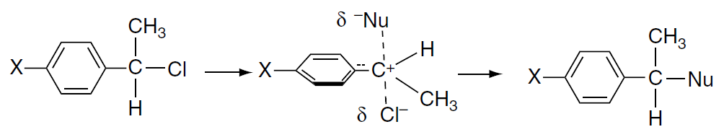
The reaction of azide ion with substituted 1-phenylethyl chlorides is an example of a coupled displacement. Although it exhibits second-order kinetics, the reaction has a substantially positive value, indicative of an electron deficiency at the TS.
The physical description of this type of activated complex is called the “exploded” S_{N}2 TS. For many secondary sulfonates, nucleophilic substitution seems to be best explained by a coupled mechanism, with a high degree of carbocation character at the TS.
The bonds to both the nucleophile and the leaving group are relatively weak, and the carbon has a substantial positive charge.

Slide 47

Basicity is a measure of the ability of a substance to attract protons and refers to an equilibrium with respect to a proton transfer from solvent:
These equilibrium constants provide a measure of thermodynamic basicity, but we also need to have some concept of kinetic basicity.
The most useful qualitative approach for making predictions is the hard-soft-acid-base (HSAB) which proposes that reactions occur most readily between species that are matched in hardness and softness.
Hard nucleophiles prefer hard electrophiles, whereas soft nucleophiles prefer soft electrophiles.

Slide 48
Figure 4.7 summarizes these ideas using a two-dimensional energy diagram. The S_{N}2(lim) mechanism corresponds to the concerted pathway through the middle of the diagram. It is favored by high-energy carbocation intermediates that require nucleophilic participation.
The S_{N}1(lim) mechanism is the path along the edge of the diagram corresponding to separate bond-breaking and bond-forming steps. An ion pair intermediate mechanism implies a true intermediate, with the nucleophile present in the TS, but at which bond formation has not progressed.
The “exploded transition state” mechanism describes a very similar structure, but one that is a transition state, not an intermediate. The importance of solvent participation in the borderline mechanisms should be noted.

Slide 49
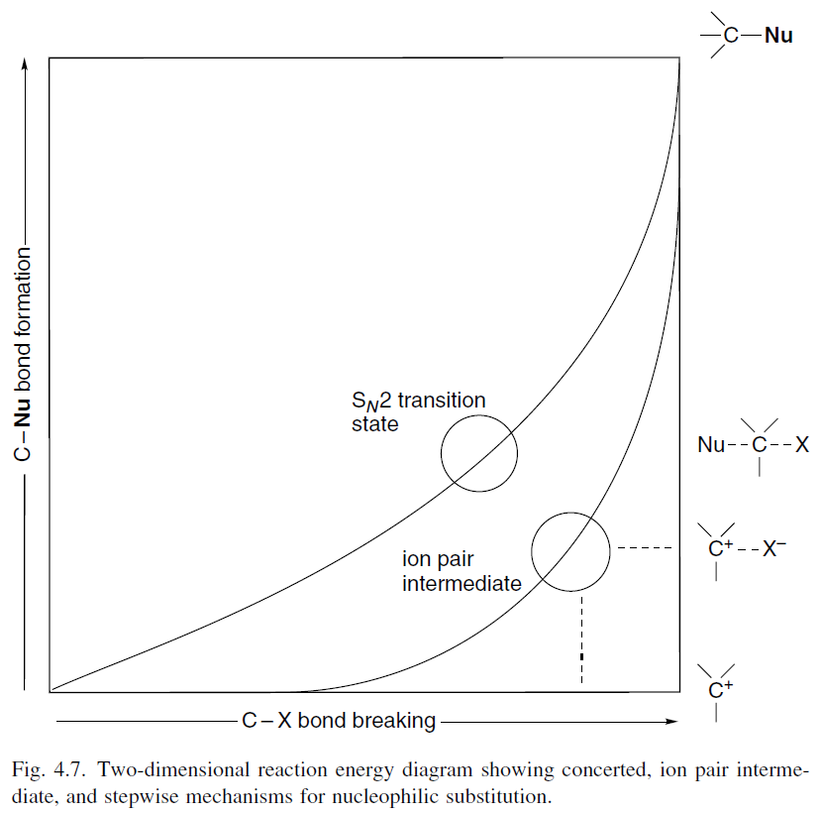

Slide 50
Solvent participation is minimized by high electronegativity and hardness, which reduce the Lewis basicity and polarizability of the solvent molecules. Trifluoroacetic acid and polyfluoro alcohols are among the least nucleophilic of the solvents commonly used in solvolysis studies.
These solvents are used to define the characteristics of reactions proceeding with little nucleophilic solvent participation. Solvent nucleophilicity increases with the electron-donating capacity of the molecule.
The order: trifluoroacetic acid (TFA) < trifluoroethanol (TFE) < acetic acid < water < ethanol gives a qualitative indication of the trend in solvent nucleophilicity.

Slide 51
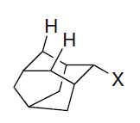
Reactant structure also influences the degree of nucleophilic solvent participation.
Solvation is minimized by steric hindrance and the 2-adamantyl system is regarded as being a secondary reactant that cannot accommodate significant back-side nucleophilic participation.
The 2-adamantyl system is used as a model reactant for defining the characteristics of ionization without solvent participation.
The degree of nucleophilic participation in other reactions can then be estimated by comparison with the 2-adamantyl system.

Slide 52
Relationship between Stereochemistry and Mechanism of Substitution
Direct displacement reactions by the S_{N}2 mechanism are expected to result in complete inversion of configuration.
The stereochemical outcome of the ionization mechanism is less predictable, because it depends on whether reaction occurs via an ion pair intermediate or through a completely dissociated ion.
Borderline mechanisms may also show variable stereochemistry, depending upon the lifetime of the intermediates and the extent of ion pair recombination.
Entry 1 shows primary systems (1-butyl-1-D-brosylate) react with inversion, even under solvolysis conditions in formic acid ( in this weakly nucleophilic solvent) (Scheme 4.2).

Slide 53
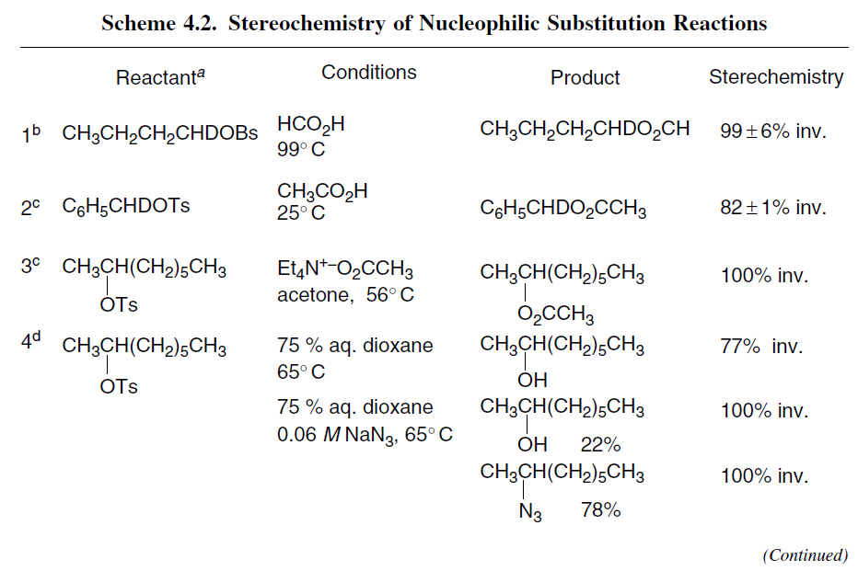

Slide 54
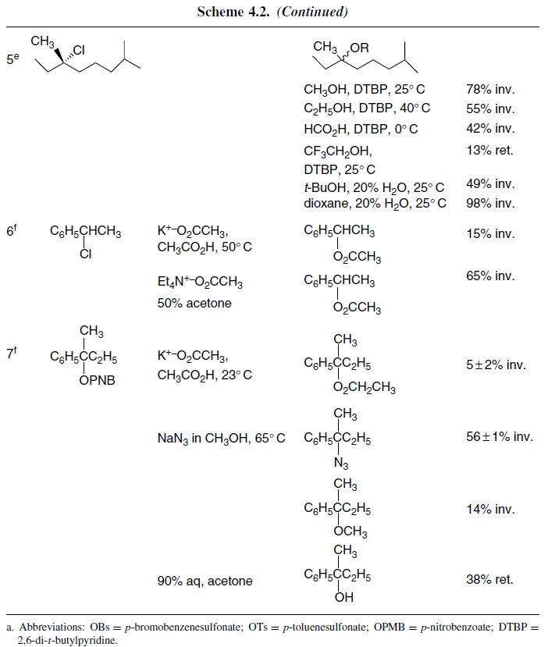

Slide 55
The primary benzyl system in Entry 2 exhibits high, but not complete, inversion for acetolysis, which is attributed to competing racemization of the reactant by ionization and internal return.
Entry 3 shows that reaction of a secondary 2-octyl system with the moderately good nucleophile acetate ion occurs with complete inversion. The results cited in Entry 4 serve to illustrate the importance of solvation of ion pair intermediates in reactions of secondary tosylates.
The data show that partial racemization occurs in aqueous dioxane but that an added nucleophile (azide ion) results in complete inversion in the products resulting from reaction with both azide ion and water.
The alcohol of retained configuration is attributed to an intermediate oxonium ion resulting from reaction of the ion pair with the dioxane solvent, which would react with water to give product of retained configuration.

Slide 56
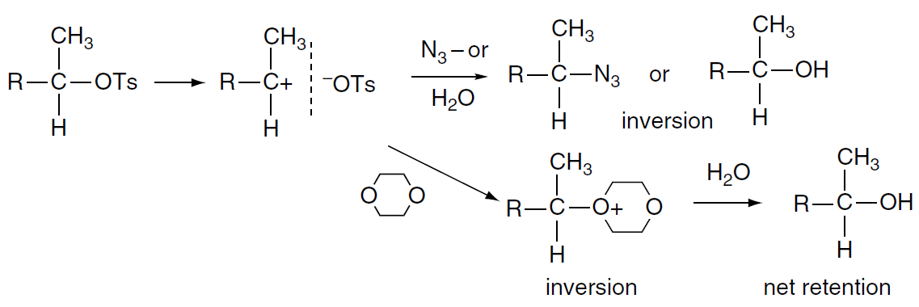
When azide ion is present, dioxane does not effectively compete for the ion pair intermediate and all of the alcohol arises from the inversion mechanism. Entry 5 shows data for a tertiary chloride in several solvents.
The results range from nearly complete inversion in aqueous dioxane to slight net retention in TFE. These results indicate that the tertiary carbocation formed does not achieve symmetrical solvation but, instead, the stereochemistry is controlled by the immediate solvation shell.
Stabilization of a carbocation intermediate by benzylic conjugation, as in the 1-phenylethyl system shown in Entry 6, leads to substitution with extensive racemization.

Slide 57
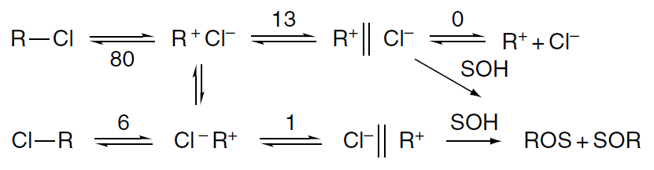
The system was analyzed in terms of the fate of the contact ion pair and solvent-separated ion pair intermediates. From this analysis, it was estimated that for every 100 molecules of 1-phenylethyl chloride that undergo ionization, 80 return to starting material of retained configuration, 7 return to inverted starting material, and 13 go on to the solvent-separated ion pair in 97:3 TFE-H₂O.
The results in Entry 7 show that even for the tertiary benzylic substrate 2-phenyl-2-butyl p-nitrobenzoate, the expectation of complete racemization is not realized. In moderately nucleophilic media, such as potassium acetate in acetic acid, this ideal is almost achieved, with just a slight excess of inversion.
The presence of the better nucleophile azide ion, however, leads to product with a significant (56%) degree of inversion. This result is attributed to nucleophilic attack on an ion pair prior to symmetrical solvation. More surprising is the observation of net retention of configuration in the hydrolysis of 2-phenyl-2-butyl p-nitrobenzoate in 90% aqueous acetone.

Slide 58
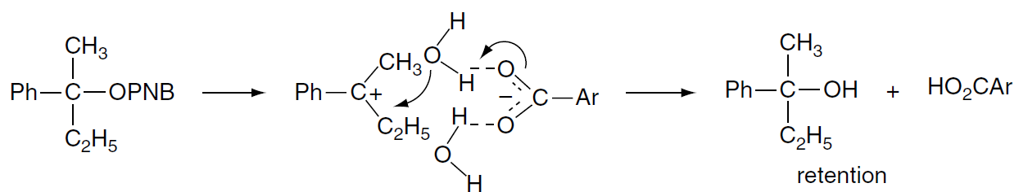
It is possible that this is the result of preferential solvent collapse from the front side at the solvent-separated ion pair stage. The bulky tertiary system may hinder solvation from the rear side. It is also possible that hydrogen bonding between a water molecule and the anion of the ion pair facilitates capture of a water molecule from the front side of the ion pair.
This selection of stereochemical results points out the relative rarity of the idealized S_{N}1 stereochemistry of complete racemization. On the other hand, the predicted inversion of the S_{N}2 mechanism is consistently observed, and inversion also characterizes the ion pair mechanisms with nucleophile participation.
Occasionally net retention is observed. The most likely cause of retention is a double-displacement mechanism, such as proposed for Entry 4, or selective front-side solvation, as in Entry 7c.

Slide 59
Substitution Reactions of Alkyldiazonium Ions
One of the most reactive leaving groups is N₂ in alkyl diazonium ions. Alkyl diazonium ions rapidly decompose to a carbocation and molecular nitrogen. Nucleophilic substitution reactions under diazotization conditions often differ significantly in stereochemistry, as compared with halide or sulfonate solvolysis. The nitrogen is only weakly bonded to the reacting carbon.
In contrast to an ionization process from a neutral substrate, which initially generates a contact ion pair, deamination reactions generate a cation that does not have a closely associated anion. Furthermore, since the leaving group is very reactive, nucleophilic participation is not needed for bond cleavage.
The leaving group, molecular nitrogen, is quite hard, and has no electrostatic attraction to the carbocation. As a result, the carbocations generated by diazonium ion decomposition frequently exhibit rather different behavior from those generated from halides or sulfonates under solvolytic conditions.

Slide 60
Table 4.1 shows displacement at the primary 1-butyl system occurs mainly by inversion (Entry 1). However, there is also extensive formation of a rearranged product, 2-butanol (not shown in the table). Similarly, the 2-butyl diazonium ion gives 28% inversion in the unrearranged product (Entry 2).
These results indicate competition between concerted rearrangement and dissociation. Several secondary diazonium ions were observed to give alcohol with predominate retention when the reaction was done in acetic acid (Entry 3). However, the acetate esters formed in these reactions is largely racemic.
Small net retention was seen in the deamination of 1-phenylpropylamine (Entry 4). The tertiary benzylic amine, 2-phenyl-2-butylamine, reacts with 24% net retention (Entry 5). These results indicate that the composition of the product is determined by collapse of the solvent shell.

Slide 61
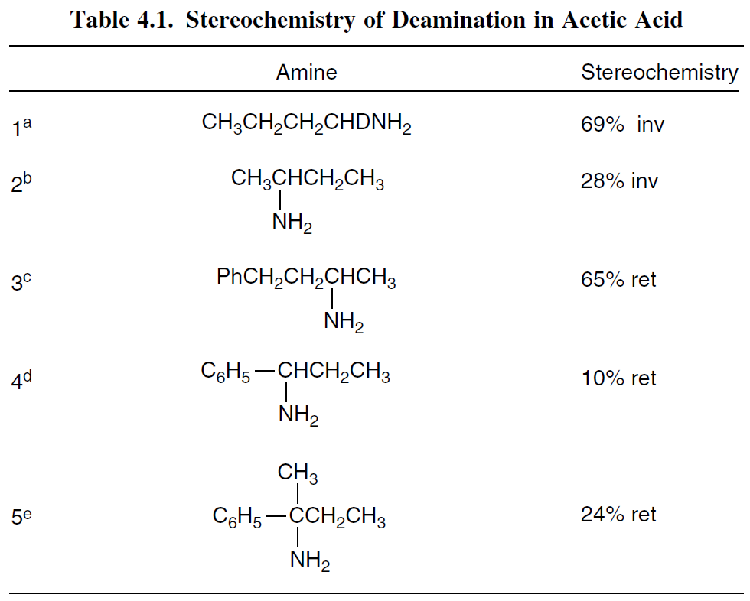

Slide 62
Considerable solvent dependence has been observed in deamination reactions. Water favors formation of a carbocation with extensive racemization, whereas less polar solvents, including acetic acid, lead to more extensive inversion as the result of solvent participation.
An analysis of the stereochemistry of deamination has also been done using 4-t-butylcyclohexylamines and the conformationally rigid 2-decalylamines. The results are summarized in Table 4.2.

Slide 63
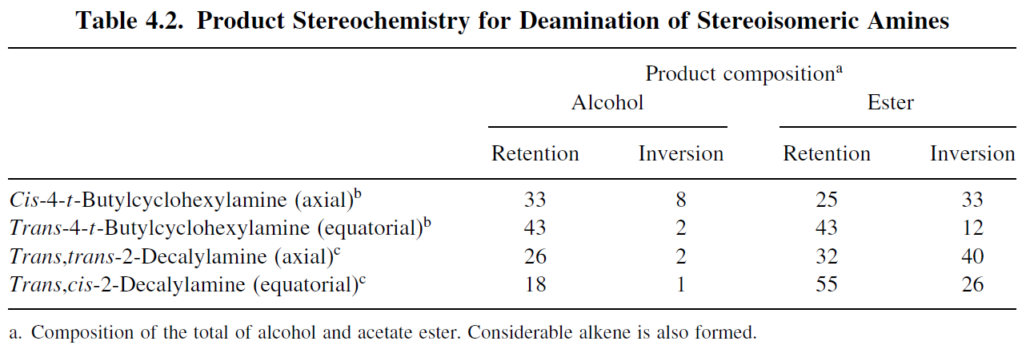

Slide 64
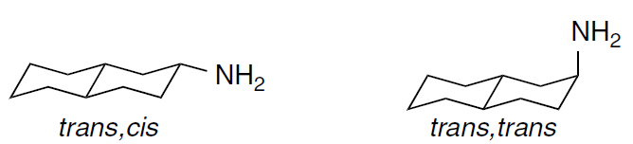

Slide 65
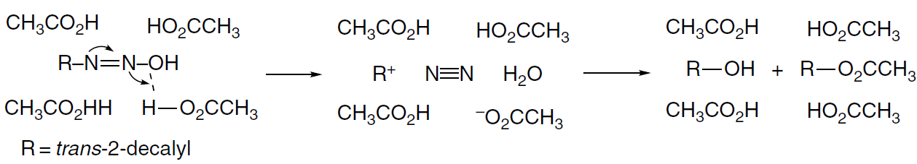
In solvent systems containing low concentrations of water in acetic acid, dioxane, or sulfolane, the alcohol is formed by capture of water with net retention of configuration. This result has been explained as involving a solvent-separated ion pair that arises by concerted proton transfer and nitrogen elimination.
The water molecule formed in the elimination step is captured preferentially from the front side, leading to net retention of configuration for the alcohol. For the ester product, the extent of retention and inversion is more balanced, although it varies among the four systems.

Slide 66
It is clear from the data in Table 4.2 that the two pairs of stereo isomeric cyclic amines do not form the same intermediate.
There are similar behavior for all alkyl diazonium ion decompositions. The low activation energy for dissociation and the neutral and hard character of the leaving group result in a carbocation that is free of direct interaction with the leaving group.
Product composition and stereochemistry is determined by the details of the collapse of the solvent shell.

Slide 67
Characteristics of Nucleophilicity
The factors that influence nucleophilicity:
(1) the solvation energy of the nucleophile
Strong solvation lowers the energy of an anionic nucleophile relative to the TS, in which the charge is more diffuse, and results in an increased E_{a}. Viewed from another perspective, the solvation shell must be disrupted to attain the TS and this dessolvation contributes to the activation energy.
(2) the strength of the bond being formed to carbon
Because the S_{N}2 process is concerted, the strength of the partially formed new bond is reflected in the TS. A stronger bond between the nucleophilic atom and carbon results in a more stable TS and a reduced activation energy.

Slide 68
(3) the electronegativity of the attacking atom
A more electronegative atom binds its electrons more tightly than a less electronegative one. The S_{N}2 process requires donation of electron density to an antibonding orbital of the reactant, and high electronegativity is unfavorable.
(4) the polarizability of the attacking atom
Polarizability describes the ease of distortion of the electron density of the nucleophile. Again, because the S_{N}2 process requires bond formation by an electron pair from the nucleophile, the more easily distorted the attacking atom, the better its nucleophilicity.

Slide 69
(5) the steric bulk of the nucleophile
A sterically congested nucleophile is less reactive than a less hindered one because of nonbonded repulsions that develop in the TS. The trigonal bipyramidal geometry of the S_{N}2 transition state is sterically more demanding than the tetrahedral reactant so steric interactions increase as the TS is approached.

Slide 70

Empirical measures of nucleophilicity are obtained by comparing relative rates of reaction of a standard reactant with various nucleophiles. One measure of nucleophilicity is the nucleophilic constant n, originally defined by Swain and Scott. Taking methanolysis of methyl iodide as the standard reaction, they defined n as:
Table 4.3 lists the nucleophilic constants for a number of species according to this definition. It is apparent that nucleophilicity toward methyl iodide does not correlate directly with aqueous basicity.

Slide 71
Azide, phenoxide, and bromide ions are equivalent in nucleophilicity, but differ greatly in basicity.
Conversely, azide ion and acetate ion are nearly identical in basicity, but azide ion is 70 times more nucleophilic.
While triethylamine is 100 times more basic than triethylphosphine (pKa of the conjugate acid is 10.7 versus 8.7), the phosphine is more nucleophilic (n is 8.7 versus 6.7), by a factor of 100 in the opposite direction.
Correlation with basicity is better if the attacking atom is the same.
Thus for the series of oxygen nucleophiles CH₃O⁻ > C₆H₅O⁻ > CH₃CO₂⁻ > NO₃⁻
nucleophilicity parallels basicity.

Slide 72
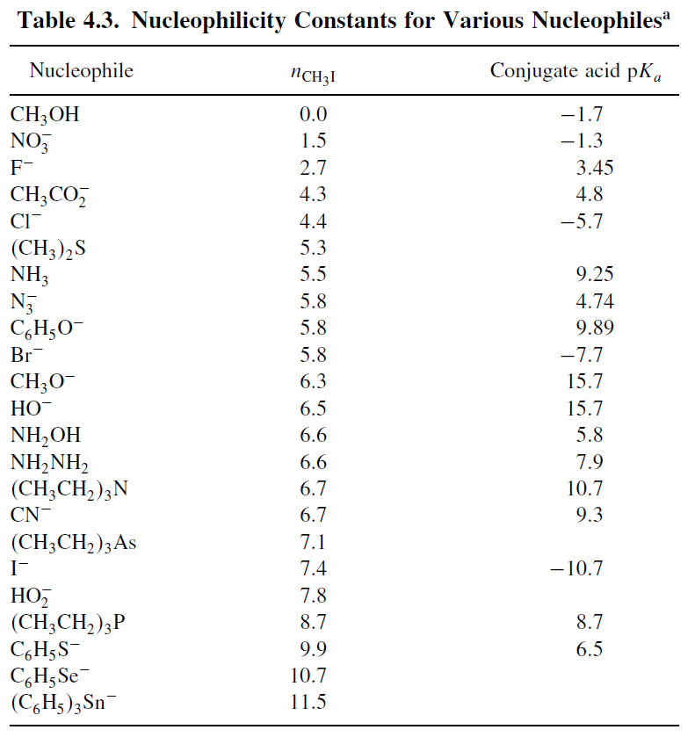

Slide 73
Nucleophilicity usually decreases going across a row in the periodic table. For example, H₂N⁻ > HO⁻> F⁻ or C₆H₅S⁻ > Cl−. This order is primarily determined by electronegativity and polarizability.
Nucleophilicity increases going down the periodic table, as, e.g., I⁻ > Br⁻ > Cl⁻> F⁻ and C₆H₅Se⁻> C₆H₅S⁻ > C₆H₅O⁻.

Slide 74
Three factors work together to determine this order:
1-Electronegativity decreases going down the periodic table.
2-The greater polarizability of the heavier ions
3-Weaker solvation of the heavier ions, which have a more diffuse electron distribution (2 and 3 are more important).
The bond strength effect is in the opposite direction, but is overwhelmed by electronegativity and polarizability.

Slide 75

There is clearly a conceptual relationship between the properties called nucleophilicity and basicity. Both describe processes involving formation of a new bond to an electrophile by donation of an electron pair.
The pKa values in Table 4.3 refer to basicity toward a proton. There are many reactions in which a given chemical species might act either as a nucleophile or as a base. It is therefore of great interest to be able to predict whether a chemical species Y⁻ will act as a nucleophile or as a base under a given set of conditions.
Basicity is a measure of the ability of a substance to attract protons and refers to an equilibrium with respect to a proton transfer from solvent:

Slide 76
These equilibrium constants provide a measure of thermodynamic basicity, but we also need to have some concept of kinetic basicity. For the reactions in Scheme 4.3, for example, it is important to be able to generalize about the rates of competing reactions.
The most useful qualitative approach for making predictions is the hard-soft-acid-base (HSAB) concept, which proposes that reactions occur most readily between species that are matched in hardness and softness. Hard nucleophiles prefer hard electrophiles, whereas soft nucleophiles prefer soft electrophiles.
The HSAB concept can be applied to the problem of competition between nucleophilic substitution and deprotonation as well as to the reaction of anions with alkyl halides.

Slide 77
HSAB
The sp³ carbon is a soft electrophile, whereas the proton is a hard electrophile. Thus, according to HSAB theory, a soft anion will act primarily as a nucleophile, giving the substitution product, whereas a hard anion is more likely to remove a proton, giving the elimination product.
Softness correlates with high polarizability and low electronegativity. The soft nucleophile–soft electrophile combination is associated with a late TS, where the strength of the newly forming bond contributes significantly to the structure and stability of the TS.

Slide 78
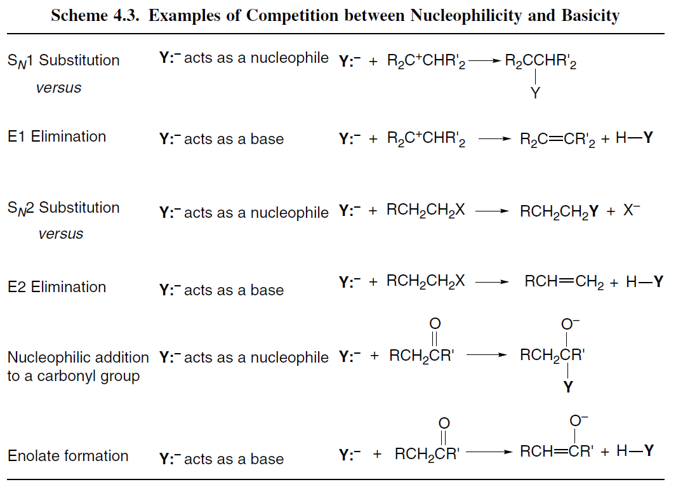

Slide 79
HSAB
Species in Table 4.3 that exhibit high nucleophilicity toward methyl iodide include CN⁻, I⁻, and C₆H₅S⁻. These are soft species.
Hardness reflects a high charge density and is associated with more electronegative elements. The hard nucleophile–hard electrophile combination implies an early TS with electrostatic attraction being more important than bond formation.
Examples of hard bases from Table 4.3 are F⁻ and CH₃O⁻. Table 4.4 classifies some representative chemical species with respect to softness and hardness.

Slide 80
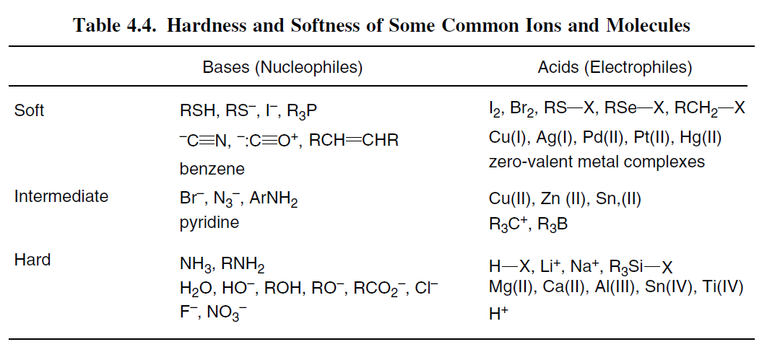

Slide 81
HSAB
Nucleophilicity is also correlated with oxidation potential for comparisons between nucleophiles involving the same element. Good nucleophilicity correlates with ease of oxidation, as would be expected from the electron-donating function of the nucleophile in S_{N}2 reactions.
HSAB considerations also suggest that nucleophilicity would be associated with species having relatively high-energy electrons. Remember that soft species have relatively high-lying HOMOs, which implies ease of oxidation.

Slide 82
Effect of Solvation on Nucleophilicity
The nucleophilicity of anions is very dependent on the degree of solvation. Many of the data that form the basis for quantitative measurement of nucleophilicity are for reactions in hydroxylic solvents.
In protic hydrogen-bonding solvents, anions are subject to strong interactions with solvent. Hard nucleophiles are more strongly solvated by protic solvents than soft nucleophiles, and this difference contributes to the greater nucleophilicity of soft anions in such solvents.
Nucleophilic substitution reactions of anionic nucleophiles usually occur more rapidly in polar aprotic solvents than they do in protic solvents, owing to the fact that anions are weakly solvated in such solvents.

Slide 83
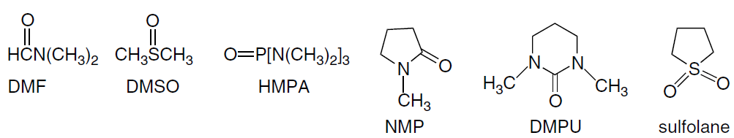
Effect of Solvation on Nucleophilicity
Nucleophilicity is also affected by the solvation of the cations in solution. Hard cations are strongly solvated in polar aprotic solvents such as N,N-dimethylformamide (DMF), dimethyl sulfoxide (DMSO), hexamethylphosphoric triamide (HMPA), N-methylpyrrolidone (NMP), N,N-dimethylpropyleneurea (DMPU), and sulfolane. As a result, the anions are dissociated from the cations, which enhances their nucleophilicity.

Slide 84
Effect of Solvation on Nucleophilicity
In the absence of the solvation by protic solvents, the relative nucleophilicity of anions changes. Hard nucleophiles increase in reactivity more than soft nucleophiles. As a result, the relative reactivity order changes.
In methanol, for example, the relative reactivity order is N₃⁻> I⁻> CN⁻> Br⁻ > Cl⁻.
In DMSO the order becomes CN⁻>N₃⁻ > Cl⁻> Br⁻ > I^{−.}
The reactivity order in methanol is dominated by solvation and the more weakly solvated N₃⁻ and I⁻ ions are the most reactive nucleophiles.

Slide 85
Effect of Solvation on Nucleophilicity
The iodide ion is large and very polarizable. The anionic charge on the azide ion is dispersed by delocalization. When the effect of solvation is diminished in DMSO, other factors become more important, including the strength of the bond being formed, which accounts for the reversed order of the halides in the two series. There is also evidence that S_{N}2 TSs are better solvated in aprotic dipolar solvents than in protic solvents.
In interpreting many aspects of substitution reactions, particularly solvolysis, it is important to be able to characterize the nucleophilicity of the solvent. Assessment of solvent nucleophilicity can be done by comparing rates of a standard substitution process in various solvents.

Slide 86

Effect of Solvation on Nucleophilicity
One such procedure is based on the Winstein-Grunwald equation: where N and Y are measures of the solvent nucleophilicity and ionizing power, respectively.
The variable parameters l and m are characteristic of specific reactions. The value of N, the indicator of solvent nucleophilicity, can be determined by specifying a standard reactant for which l is assigned the value 1.00 and a standard solvent for which N is assigned the value 0.00. The parameters were originally assigned for solvolysis of t-butyl chloride.
The scale has also been assigned for 2-adamantly tosylate, in which nucleophilic participation of the solvent is considered to be negligible. Ethanol-water in the ratio 80:20 is taken as the standard solvent. The resulting solvent characteristics are called N_{Tos} and Y_{Tos}. Some representative values for solvents that are frequently used in solvolysis studies are given in Table 4.5.

Slide 87
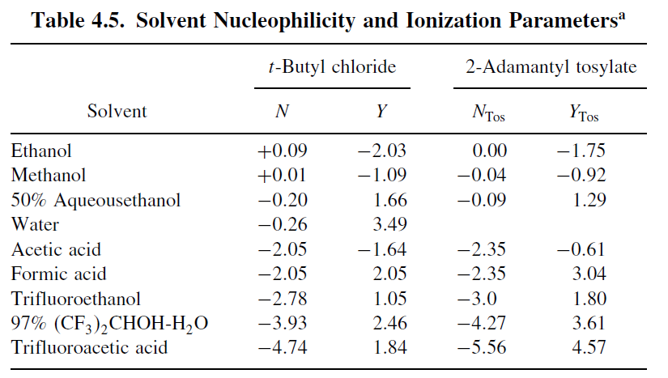

Slide 88
Effect of Solvation on Nucleophilicity
We see that nucleophilicity decreases from ethanol to water to trifluoroethanol to trifluoroacetic acid as the substituent becomes successively more electron withdrawing.
Note that the considerable difference between acetic acid and formic acid appears entirely in the Y terms, which have to do with ionizing power and results from the more polar character of formic acid.
The nucleophilicity parameters of formic acid and acetic acid are the same, as might be expected, because the nucleophilicity is associated with the carboxy group.

Slide 89
Leaving-Group Effects
The nature of the leaving group influences the rate of reaction of ethyl arenesulfonates with ethoxide ion in ethanol.
Table 4.6 lists estimated relative rates of solvolysis of 1-phenylethyl esters and halides in 80% aqueous ethanol at 75 º C. The reactivity of the leaving groups generally parallels their electron-accepting capacity.
Trifluoroacetate, for example, is about 10⁶ time as reactive as acetate and p-nitrobenzenesulfonate is about 10 times more reactive than p-toluenesulfonate. The order of the halide leaving groups is I⁻ >Br⁻ > Cl⁻> F⁻.
This order is opposite to that of electronegativity and is dominated by the strength of the bond to carbon, which increases from ∼ 55 kcal for the C−I bond to ∼ 110 kcal for the C−F bond.

Slide 90
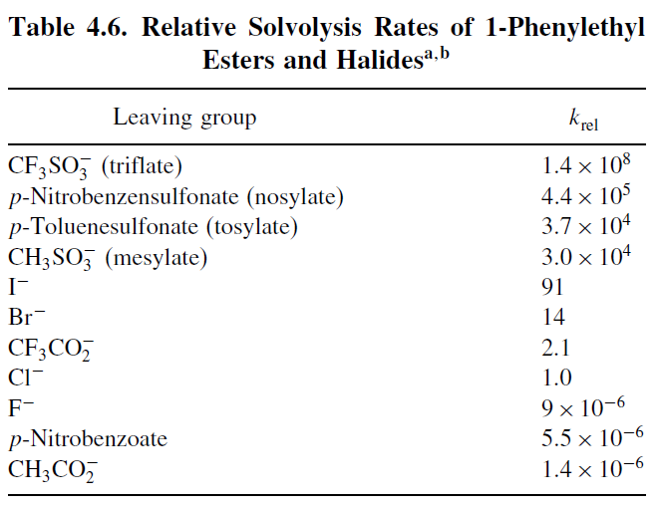

Slide 91

Leaving-Group Effects
Trifluoromethanesulfonate (triflate) ion is an exceptionally reactive leaving group and can be used for nucleophilic substitution reactions on unreactive substrates.
Acetolysis of cyclopropyl triflate, for example, occurs 10⁵ times faster than acetolysis of cyclopropyl tosylate.
Sulfonate esters are usually prepared by reaction of an alcohol with a sulfonyl halide in the presence of pyridine. Sulfonate esters are especially useful reactants in nucleophilic substitution reactions in synthesis. Tertiary alcohols are more difficult to convert to sulfonate esters and their high reactivity often makes them difficult to isolate.

Slide 92
Leaving-Group Effects
It would be anticipated that the limiting S_{N}1 and S_{N}2 mechanisms would differ in their sensitivity to the nature of the leaving group.
The ionization mechanism should exhibit a greater dependence on leaving-group ability because it requires cleavage of the bond to the leaving group without assistance by the nucleophile.
The dependence on structure is as expected, with smaller differences in reactivity between tosylate and bromide being observed for systems that react by the S_{N}2 mechanism. The largest differences are seen for tertiary systems, where nucleophilic participation is minimal.

Slide 93
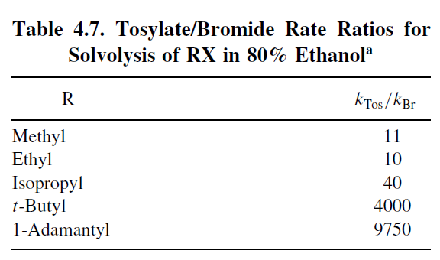

Slide 94

Leaving-Group Effects
Leaving-group effects are diminished in S_{N}2 reactions, because the nucleophile assists in bond breaking. The mesylate/bromide ratio is compressed from 2×10³ (Table 4.6) to only about 10 for azide ion in methanol, as shown in Table 4.8.
In the aprotic dipolar solvent DMF, the leaving-group order is I⁻ >Br⁻ >⁻O₃SCH₃ for both azide and thiocyanate anions. A poor leaving group can be made more reactive by coordination to an electrophile.
Hydroxide is a very poor leaving group, so alcohols do not normally undergo direct nucleophilic substitution since, the reaction is too slow to detect at normal temperature, but it is greatly accelerated in acidic solution.

Slide 95
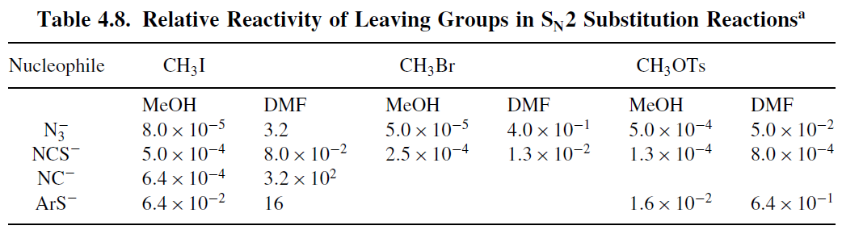

Slide 96
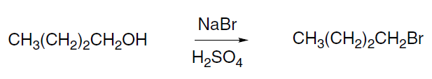
Leaving-Group Effects
Protonation of the hydroxyl group provides the much better leaving group—water—which is about as good a leaving group as bromide ion.
The practical result is that primary alcohols can be converted to alkyl bromides by heating with sodium bromide and sulfuric acid or with concentrated hydrobromic acid.
The reactivity of halides is increased by coordination with Lewis acids. For example, silver ion accelerates solvolysis of methyl and ethyl bromide in 80:20 ethanol water by more than 10³.

Slide 97
Steric and Strain Effects on Substitution and Ionization Rates
Reactions that proceed by the direct displacement mechanism are retarded by increased steric repulsions at the TS.
This is the principal cause for the relative reactivity of methyl, ethyl, and i-propyl chloride, which are in the ratio 93:1:0.0076 toward iodide ion in acetone.
Table 4.9 shows some of the data. The first three examples pertain to S_{N}2 reactions. Note that the fourth entry, involving solvolysis in acetic acid, shows a diminished sensitivity to steric effects.
As acetic acid is a much weaker nucleophile than the other examples, the TS involves less nucleophilic participation.

Slide 98
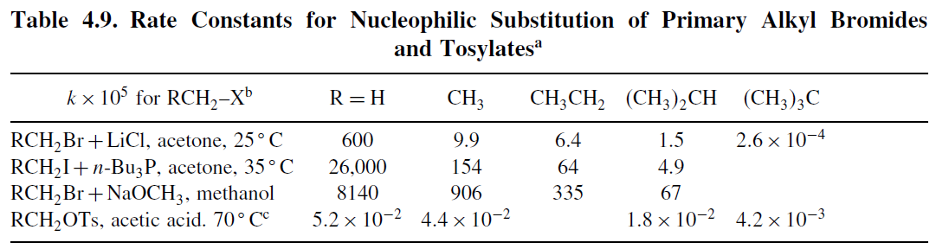

Slide 99
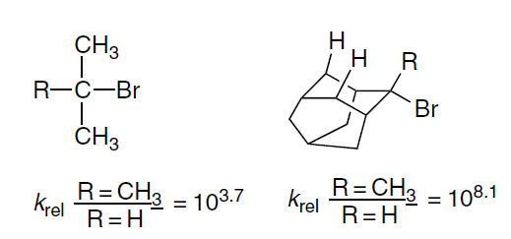
Steric and Strain Effects
In contrast to S_{N}2 reactions, rates of reactions involving TSs with cationic character increase with substitution. The relative rates of formolysis of alkyl bromides at 100 ºC are methyl, 0.58; ethyl, 1.00; i-propyl, 26.1; and t-butyl 108.
This order is clearly dominated by carbocation stability. The effect of substituting a methyl group for hydrogen depends on the extent of nucleophilic participation in the TS. A high CH₃/H rate ratio is expected if nucleophilic participation is weak and stabilization of the cationic nature of the TS is important.
A low ratio is expected when nucleophilic participation is strong. The relative rate of acetolysis of t-butyl bromide to i-propyl bromide at 25 ºC is 10^{3.7}, whereas that of 2-methyl-2-adamantyl bromide to 2-adamantyl bromide is 10^{8.1}.

Slide 100
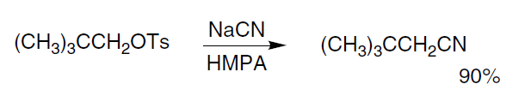
Steric and Strain Effects
The reason the adamantyl system is much more sensitive to the CH₃ for H substitution is that its cage structure precludes solvent participation, whereas the i-propyl system allows much greater solvent participation. The electronic stabilizing effect of the methyl substituent is therefore more important in the adamantyl system.
Neopentyl (2,2-dimethylpropyl) systems are resistant to nucleophilic substitution reactions. They are primary and do not form carbocation intermediates; moreover the t-butyl substituent hinders back-side displacement.
The rate of reaction of neopentyl bromide with iodide ion is 470 times less than that of n-butyl bromide. Under solvolysis conditions the neopentyl system usually reacts with rearrangement to the t-pentyl system, although use of good nucleophiles in polar aprotic solvents permits direct displacement to occur.

Slide 101
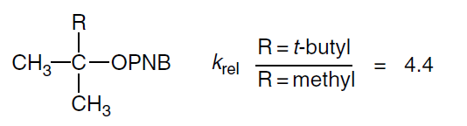
Steric and Strain Effects
Steric effects of another kind become important in highly branched substrates, and ionization can be facilitated by relief of steric crowding in going from the tetrahedral ground state to the TS for ionization.
The relative hydrolysis rates in 80% aqueous acetone of t-butyl p-nitrobenzoate and 2,3,3-trimethyl-2-butyl p-nitrobenzoate are 1:4.4. This effect has been called B-strain (back strain), and in this example only a modest rate enhancement is observed.
As the size of the groups is increased, the effect on rate becomes larger. When all three of the groups in the above example are t-butyl, the solvolysis occurs 13,500 times faster than in t-butyl p-nitrobenzoate.

Slide 102
Effects of Conjugation on Reactivity

Slide 103
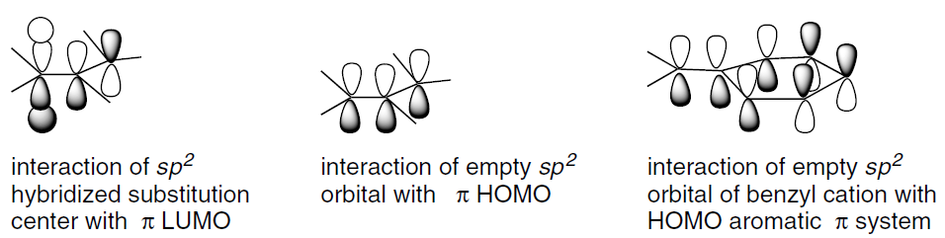
In addition to steric effects, there are other important substituent effects that influence both the rate and mechanism of nucleophilic substitution reactions. The benzylic and allylic cations are stabilized by electron delocalization.
It is therefore easy to understand why substitution reactions of the ionization type proceed more rapidly in these systems than in alkyl systems. Direct displacement reactions also take place particularly rapidly in benzylic and allylic systems.

Slide 104
For example, allyl chloride is 33 times more reactive than ethyl chloride toward iodide ion in acetone. These enhanced rates reflect stabilization of the S_{N}2 TS through overlap of the p-type orbital that develops at carbon. The systems of the allylic and benzylic groups provide extended conjugation.
This conjugation can stabilize the TS, whether the substitution site has carbocation character and is electron poor or is electron rich as a result of a concerted S_{N}2 mechanism.

Slide 105
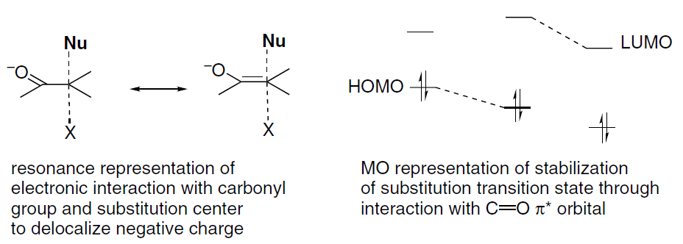
Carbonyl groups also affect reactivity. Substitution by the ionization mechanism proceeds slowly on α-halo derivatives of ketones, aldehydes, acids, esters, nitriles, and related compounds. Such substituents destabilize a carbocation intermediate, but substitution by the direct displacement mechanism proceeds especially readily in these systems.

Slide 106
Table 4.10 indicates some representative relative rate accelerations. Steric effects may be responsible for part of the observed acceleration, since an sp² carbon, such as in a carbonyl group, offers less steric resistance to the incoming nucleophile than an alkyl group.
The major effect is believed to be electronic. The adjacent LUMO of the carbonyl group can interact with the electron density that builds up at the pentacoordinate carbon in the TS.
This can be described in resonance terminology as a contribution from an enolate-like structure to the TS. In MO terminology, the low-lying LUMO has a stabilizing interaction with the developing p orbital of the TS.

Slide 107
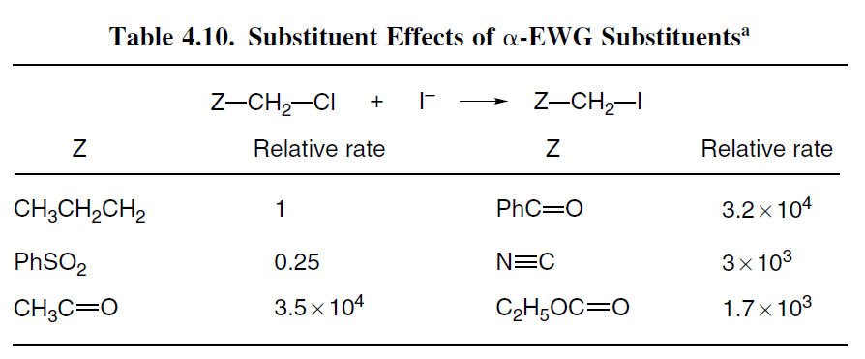

Slide 108
It should be noted that not all electron-attracting groups enhance reactivity. The sulfonyl and trifluoro groups, which cannot participate in this type of conjugation, retard the rate of S_{N}2 substitution at an adjacent carbon.
The extent of the rate enhancement of adjacent substituents is dependent on the nature of the TS. The most important factor is the nature of the π-type orbital that develops at the trigonal bipyramidal carbon in the TS.

Slide 109
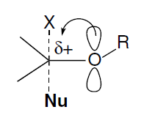
If the carbon is cationic in character, electron donation from adjacent substituents becomes stabilizing. If bond formation at the TS is advanced, resulting in charge buildup at carbon, electron withdrawal is more stabilizing.
Thus substituents such as carbonyl have their greatest effect on reactions with strong nucleophiles. Adjacent alkoxy substituents act as donors and can stabilize S_{N}2 TSs that are cationic in character. Vinyl and phenyl groups can stabilize either type of TS, and allyl and benzyl systems show enhanced reactivity toward both strong and weak nucleophiles

Slide 110
Neighboring-Group Participation

Slide 111
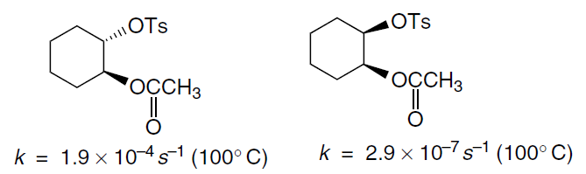
When a molecule that can react by nucleophilic substitution also contains a substituent group that can act as a nucleophile, it is often observed that the rate and stereochemistry of the nucleophilic substitution are strongly affected.
The involvement of nearby nucleophilic substituents in a substitution process is called neighboring group participation. A classic example of neighboring-group participation involves the solvolysis of compounds in which an acetoxy substituent is present next to the carbon that is undergoing nucleophilic substitution.
For example, the rates of solvolysis of the cis and trans isomers of 2-acetoxycyclohexyl p-toluenesulfonate differ by a factor of about 670, the trans compound being more reactive than cis isomer.

Slide 112
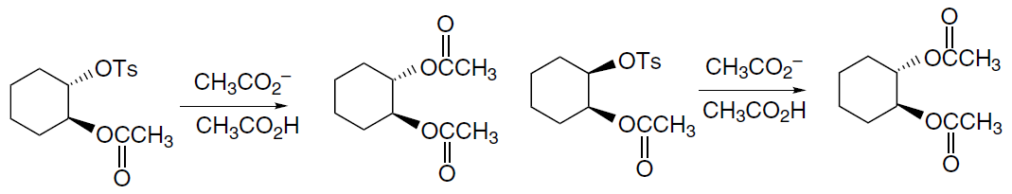
Besides the pronounced difference in rate, the isomeric compounds reveal a striking difference in stereochemistry. The diacetate obtained from the cis isomer is the trans compound (inversion), whereas retention of configuration is observed for the trans isomer.
These results can be explained by the participation of the trans acetoxy group in the ionization process. The assistance provided by the acetoxy carbonyl group facilitates the ionization of the tosylate group, accounting for the rate enhancement.
This kind of back-side participation by the adjacent acetoxy group is both sterically and energetically favorable. The cation that is formed by participation is stabilized by both acetoxy oxygen atoms and is far more stable than a secondary carbocation.
The resulting acetoxonium ion intermediate is subsequently opened by nucleophilic attack with inversion at either of the two equivalent carbons, leading to the observed trans product.

Slide 113
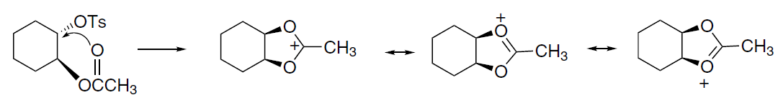

When enantiomerically pure trans-2-acetoxycyclohexyl tosylate is solvolyzed, the product is racemic trans-diacetate. This result is consistent with the proposed mechanism, because the acetoxonium intermediate is achiral and can only give rise to racemic material.
Additional evidence for this interpretation comes from the isolation of a cyclic orthoester when the solvolysis is carried out in ethanol, where the acetoxonium ion is captured by the solvent.

Slide 114


The hydroxy group can act as an intramolecular nucleophile. Solvolysis of 4-chlorobutanol in water gives tetrahydrofuran as the product. The reaction is much faster than solvolysis of 3-chloropropanol under similar conditions. Participation in the latter case is less favorable because it involves formation of a strained four membered ring.
The alkoxide ions formed by deprotonation in basic solution are even more effective nucleophiles. In ethanol containing sodium ethoxide, 2-chloroethanol reacts about 5000 times faster than ethyl chloride. The product is ethylene oxide, confirming the involvement of the oxygen atom as a nucleophile.

Slide 115

As would be expected, the effectiveness of neighboring-group participation depends on the ease with which the molecular geometry required for participation can be attained. The rate of cyclization of ω-hydroxyalkyl halides, for example, shows a strong dependence on the length of the chain separating the two groups.
Some data are given in Table 4.11. The maximum rate occurs for the 4-hydroxybutyl system involving formation of a five-membered ring.
Like the un-ionized hydroxyl group, an alkoxy group is a weak nucleophile, but it can function as a neighboring nucleophile. For example, solvolysis of the isomeric p-bromobenzenesulfonate esters 1 and 2 leads to identical product mixtures, indicating the involvement of a common intermediate.

Slide 116
This can occur by formation of a cyclic oxonium ion by intramolecular participation. The occurrence of nucleophilic participation is also indicated by a rate enhancement.
The maximum rate enhancement is observed when participation of a methoxy group occurs via a five-membered ring (see Table 4.12).

Slide 117


Slide 118


Slide 119
Table 4.13 provides data on two series of intramolecular nucleophilic substitution. One data set pertains to cyclization of ω-bromoalkylmalonate anions and the other to lactonization of ω-bromocarboxylates. Both reactions occur by direct displacement mechanisms.
The dissection of the E_{a} of ring-closure reactions into enthalpy and entropy components shows some consistent features.

Slide 120


Slide 121
The ∆H‡ for formation of three and four-membered rings is normally higher than for five- and six-membered rings, whereas ∆S‡ is least negative for three-membered rings. The ∆S‡ is comparable for four-, five-, and six-membered rings and then becomes more negative as the ring size increases above seven.
The ∆H‡ term reflects the strain that develops in the closure of three-membered rings, whereas the more negative entropy associated with larger rings indicates the decreased probability of encounter of the reaction centers as they get farther apart. Because of the combination of these two factors, the maximum rate is usually observed for the five- and six-membered rings.

Slide 122
In general, any system that has a nucleophilic substituent situated properly for back-side displacement of a leaving group at another carbon atom of the molecule can be expected to display neighboring-group participation.
The extent of the rate enhancement depends on how effectively the group acts as an internal nucleophile. The existence of participation may be immediately obvious from the structure of the product if a derivative of the cyclic intermediate is stable.
In other cases, demonstration of kinetic acceleration or stereochemical consequences may provide the basis for identifying nucleophilic participation.

Slide 123

The π electrons of carbon-carbon double bonds can also become involved in nucleophilic substitution reactions. This participation can facilitate the ionization step if it leads to a carbocation having special stability.
Solvolysis reactions of the syn and anti isomers of 7-norbornenyl tosylates provide some dramatic examples of the influence of participation by double bonds on reaction rates and stereochemistry.
The anti-tosylate is more reactive by a factor of about 10¹¹ than the saturated analog toward acetolysis. The reaction product, anti-7-acetoxynorbornene, is the product of retention of configuration.
These results can be explained by participation of the π electrons of the double bond to give the ion 3, which is stabilized by delocalization of the positive charge.

Slide 124

In contrast, the syn isomer, where the double bond is not in a position to participate in the ionization step, reacts 10⁷ times slower than the anti isomer.
The reaction product in this case is derived from a rearranged carbocation ion that is stabilized by virtue of being allylic participation of carbon-carbon double bonds in solvolysis reactions is revealed in some cases by isolation of products with new carbon-carbon bonds.

Slide 125


A particularly significant case is the formation of the bicyclo[2.2.1]heptane ring during solvolysis of 2-cyclopent-3-enylethyl tosylate. In this case, the participation leads to the formation of the norbornyl cation, which is captured as the acetate.
A system in which the participation of aromatic π electron has been thoroughly probed is the “phenonium” ions, the species resulting from participation by a ß-phenyl group.

Slide 126

Such participation leads to a bridged carbocation with the positive charge delocalized into the aromatic ring. Evidence for this type of participation was first obtained by a study of the stereochemistry of solvolysis of 3-phenyl-2-butyl tosylates.
The erythro isomer gave largely retention of configuration, a result that can be explained via a bridged ion intermediate. The threo isomer, where participation leads to an achiral intermediate, gave racemic threo product.

Slide 127

The relative importance of aryl participation is a function of the substituents on the ring. The extent of participation can be quantitatively measured by comparing the rate of direct displacement, k_{s} , with the rate of aryl-assisted solvolysis, designated k∆.
1. The relative contributions to individual solvolyses can be distinguished by taking advantage of the higher sensitivity to aryl substituent effects of the assisted mechanism.
In systems with EWG substituents, the aryl ring does not participate effectively and only the process described by k_{s} contributes to the rate. Such compounds give a Hammett correlation with ρ values (−0.7 to −0.8) characteristic of a weak substituent effect.

Slide 128
Compounds with ERG substituents deviate from the correlation line because of the aryl participation. The extent of reaction proceeding through the k_{s} process can be estimated from the correlation line for electron-withdrawing substituents. Table 4.14 gives data indicating the extent of aryl rearrangement for several substituents in different solvents.
2. This method of analysis shows that the relative extent of participation of the β-phenyl groups is highly dependent on the solvent. In solvents of good nucleophilicity (e.g., ethanol), the normal solvent displacement mechanism makes a larger contribution. As solvent nucleophilicity decreases, the relative extent of aryl participation increases.

Slide 129


Slide 130

The bridged form of the ß-phenylethyl cation can be observed in superacid media and characterized by carbon and proton NMR spectra. The bridged ion subsequently rearranges to the more stable α-methylbenzyl cation with E_{a} of about 13 kcal/mol.

Slide 131

High-level MO and DFT calculations have been performed on the bridged ion. The bond length to C(1) from C(7) and C(8) is 1.625 Å, whereas the C(7)−C(8) bond length is 1.426 Å. The phenonium ion has a good deal of delocalization of the electron deficiency and the resulting positive charge into the cyclopropane ring. This occurs by overlap of the cyclopropyl orbitals with the π system.

Slide 132


Structure and Stability of Carbocations
The critical step in the ionization mechanism is the generation of the carbocation intermediate. It is essential that the carbocation not be prohibitively high in energy. Carbocations are inherently high-energy species. The ionization of t-butyl chloride is endothermic by 153 kcal/mol in the gas phase.
An activation energy of this magnitude would lead to an unobservably slow reaction at normal temperature. Carbocation formation in solution is feasible because of solvation of the ions that are produced. It is also important to understand the effect of structure and substituents have on carbocation stability.
A method that is applicable to highly stabilized cations is to determine the extent of carbocation formation from the parent alcohol in acidic solution. The triarylmethyl cations are stabilized by the conjugation that delocalizes the positive charge. In acidic solution, equilibrium is established between triarylcarbinols and the corresponding carbocation:

Slide 133

The relative stability of the carbocation can be expressed in terms of its pK_{R+} , which is defined as where H_{R} is an acidity function defined for the medium. In dilute aqueous solution, H_{R} is equivalent to pH, and pK_{R+} is equal to the pH at which the carbocation and alcohol are present in equal concentrations.
The values shown in Table 4.15 were determined by measuring the extent of carbocation formation at several acidities and applying the definition of pK_{R+} . The pK_{R+} values allow for a comparison of the stability of relatively stable carbocations. The data in Table 4.15 show that ERG substituents on the aryl rings stabilize the carbocation (less negative pK_{R+}), whereas EWGs such as nitro are destabilizing. This is as expected from the electron-deficient nature of carbocations.

Slide 134
The diarylmethyl cations listed in Table 4.14 are 6–7 pK_{R+} units less stable than the corresponding triarylmethyl cations. This indicates that the additional aryl groups have a cumulative, although not necessarily additive, effect on the stability of the carbocation. Primary benzylic cations are generally not sufficiently stable for direct determination of pK_{R+} values.
A value of ≤ -20 has been assigned to the benzyl cation based on rate measurements for the forward and reverse reactions. A particularly stable benzylic ion, the 2,4,6-trimethylphenylmethyl cation has a pK_{R+} of −17.4. t-Alkyl cations have pK_{R+} values around −15.

Slide 135


Slide 136

Several very stable carbocations are included in the “Other Carbocations” part of Table 4.15. The tricyclopropylmethyl cation, for example, is more stable than the triphenylmethyl cation.
The stabilization of carbocations by cyclopropyl substituents results from the interaction of the cyclopropyl bonding orbitals with the vacant carbon p-orbital. The electrons in these orbitals are at relatively higher energy than normal σ-electrons and are therefore particularly effective in interacting with the vacant p-orbital of the carbocation.
This interaction imposes a stereoelectronic preference for the bisected conformation of the cyclopropylmethyl cation in comparison to the perpendicular conformation. Only the bisected conformation aligns the cyclopropyl C−C orbitals for effective overlap.

Slide 137



Carbocation stability can also be expressed in terms of hydride affinity. Hydride affinity values based on solution measurements can be derived from thermodynamic cycles that relate pK_{a} and electrochemical potentials. The hydride affinity, −∆G, for the reaction is a measure of carbocation stability.
This quantity can be related to an electrochemical potential by summation with the energy for hydrogen atom removal, i.e., the hemolytic bond dissociation energy. where (Hº/H⁻) and (R⁺/Rº) are one-electron oxidation potentials for H⁻ and Rº.
So:

Slide 138
The former potential is about −0.55V in DMSO. Measurement of R⁺/Rº can be accomplished by cyclic voltammetry for relatively stable carbocations and by other methods for less stable cations. The values obtained range from 83 kcal/mol for the aromatic tropylium ion to 130 kcal/mol for a benzylic cation destabilized by a EWG substituents. Some of these data are included in Table 4.16.
Note that these values are considerably smaller than the corresponding gas phase values, which range from 200 kcal/mol for tropylium ion to 239 kcal/mol for the benzyl cation, although the difference in stability is quite similar. This is the result of solvent stabilization.
It is possible to obtain thermodynamic data for the ionization of alkyl chlorides by reaction with SbF₅, a strong Lewis acid, in the nonnucleophilic solvent SO₂ClF. The solvation energies of the carbocations in this medium are small and do not differ much from one another, which makes comparison of nonisomeric systems reasonable.

Slide 139


Slide 140
As long as subsequent reactions of the carbocation can be avoided, the thermodynamic characteristics of the ionization reactions provide a measure of the relative ease of carbocation formation in solution.
There is good correlation between these data and the gas phase data, in terms of both the stability order and the energy differences between the carbocations.
A plot of the ionization enthalpy and gas phase hydride affinity gives a line of slope 1.63 with a correlation coefficient of 0.973. This result is in agreement with the expectation that the gas phase stability would be more sensitive to structure than the solution phase stability.
The energy gap between tertiary and secondary ions is about 17 kcal/mol in the gas phase and about 9.5 kcal/mole in the SO₂ClF solution.

Slide 141
An independent measurement of the energy difference between secondary and tertiary cations in solution is available from calorimetric measurement of the ∆H of isomerization of the sec-butyl cation to the tert-butyl cation. This value has been found to be 14.5 kcal/mol in SO₂ClF solution.
An MP2/6-31G∗ computation finds a difference of 14.8 kcal. Some representative data are given in Table 4.17. These data give some basis for comparison of the stability of secondary and tertiary alkyl carbocations with aryl-substituted ions.
Note that the solution data also show that cyclopropyl groups are very stabilizing toward carbocations. The increase in carbocation stability with additional alkyl substitution is one of the most important and general trends in organic chemistry.

Slide 142


Slide 143
This stability relationship is fundamental to understanding many aspects of reactivity, especially nucleophilic substitution. Hyperconjugation is the principal mechanism by which alkyl substituents stabilize carbocations.
There is considerable evidence of the importance of hyperconjugation on the structure of carbocations, including NMR data, crystallographic data, and computational studies.
The tert-butyl cation has been studied by each method. The NMR results indicate shortening of the C−C bonds, as would be predicted by hyperconjugation. The crystal structure gives a value of 1.44 Å.
A computational study at the MP2/6-31G∗∗ level shows a slight elongation of the C−H bonds aligned with the p orbital, and the C−C−H bond angles are slightly reduced (Figure 4.8).

Slide 144


Slide 145

Levy has performed NPA, Mulliken, AIM, and CHELPG charge analyses on the iso-propyl, sec-butyl, and tert-butyl cations using MP2/6-31G∗-level computations.
The trivalent carbon atom in tert-butyl cation is found to be more positive than the carbon in the secondary ions. The adjacent carbons bear negative charges, as a result of electron donation from hydrogen.
The charges on hydrogen range from +0.26 to +0.38, averaging +0.32 in the tert-butyl cation, according to the NPA analysis. This is consistent with the representation of the stabilizing effect in terms of hyperconjugation.
This analysis also suggests that a significant part of the stabilization of the tert-butyl cation comes from the favorable electrostatic consequence of alternating positive and negative charges.

Slide 146

The 2-methyl-2-butyl cation provides the opportunity to compare C−C and C−H hyperconjugation. At the MP4/6-31G∗∗ level of calculation, little energy difference is found between structures A and B, which differ in alignment of CH₃ or H with the empty p orbital.
Structure A, however, gives a much closer approximation to the observed ¹³C chemical shift and thus seems to be preferred. The calculations also indicate a lengthening of the C(3)−C(4) bond (to 1.58 Å) and a contraction of the C(2)−C(3)−C(4) bond angle to 101.5 º, both of which are consistent with C−C hyperconjugation.
A particularly interesting example of the effect of hyperconjugation is found in the 1-methylcyclohexyl carbocation. The NMR spectrum of this cation reveals the presence of two isomeric cations that are separated by a small barrier.

Slide 147

Investigation of the NMR chemical shifts using the MP2-GIAO method points to an axial and equatorial isomer of nearly equal energy. B3LYP/6-31G∗ calculations indicate an energy difference of about 0.6 kcal and suggest that the (nearly planar) TS is about 0.9 kcal above the minimum energy structure.
The cationic carbon is slightly pyramidalized toward the C−C or C−H bonds involved in hyperconjugation. The reason for the pyramidalization is better alignment with the C−C and C−H bonds that provide hyperconjugative stabilization. The hyperconjugation is also indicated by the differing shapes of the LUMO orbitals for the isomeric ions shown in Figure 4.9.

Slide 148


Slide 149

It is important to note the relationship of C−H and C−C hyperconjugation to the reactivity as well as the structure of carbocations. Hyperconjugation represents electron sharing with an empty orbital and can lead to structural changes or reactions.
If the electron density is substantially shared between the two atoms, the structure is bridged. If the electron sharing results in a shift of the donor group, rearrangement occurs. As we saw in Section 3.4.1, the ethyl cation is bridged.

Slide 150

The 1-adamantyl carbocation provides another example of C−C hyperconjugation. The Cα-Cβ bond is shortened by 0.06Å in the crystal structure. The NMR spectrum also shows characteristics of delocalization of the positive charge. A computational study also indicates delocalization of the positive charge.

Slide 151

Larger primary cations rearrange to more stable carbocations; for example, the 1-propyl cation rearranges to the 2-propyl cation and a neopentyl cation rearranges to a t-pentyl cation. These rearrangements are the culmination of electron donation by formation of a new bond.
Within any given series of carbocations, substituents affect stability in predictable ways. ERG substituents stabilize carbocations, whereas EWG substituents destabilize them. Careful attention must be paid to both resonance and polar effects.

Slide 152

The resonance effect is very strong for substituents directly on the cationic carbon. Benzylic cations are strongly stabilized by resonance interactions with the aromatic ring. Substituent effects can be correlated by the Yukawa-Tsuno equation.
For example, gas phase chloride ion affinities correlate with the Yukawa-Tsuno equation with ρ = −14.0 and r⁺ = 1.29, indicating a strong resonance interaction. A molecular orbital calculation estimating the stabilization was done using STO-3G–level basis functions.

Slide 153

The electron-donating p-amino and p-methoxy groups were found to stabilize a benzyl cation by 26 and 14 kcal/mol, respectively. On the other hand, electron attracting groups such as p-cyano and p-nitro were destabilizing by 12 and 20 kcal/mol, respectively.

Slide 154
Adjacent atoms with one or more unshared pairs of electrons strongly stabilize a carbocation. Table 3.11 (p. 304) indicates the stabilization of the methyl cation by such substituents. Alkoxy and dialkylamino groups are important examples of this effect.

Slide 155

Although these structures have a positive charge on a more electronegative atom, they benefit from an additional bond that satisfies the octet requirement of the tricoordinate carbon. These “carbocations” are best represented by the doubly bonded resonance structures.
One indication of the strong participation of adjacent oxygen substituents is the existence of a barrier to rotation about the C−O bonds in this type of carbocation. The barrier in A is about 14 kcal/mole (∆G∗) as measured by NMR coalescence of the nonidentical vinyl protons.

Slide 156
The gas phase barrier is calculated by MO methods to be 26 kcal/mol. The observed barrier for B is 19 kcal/mol. Even halogen substituents stabilize carbocations as a result of resonance donation from the halogen electron pairs. A fluorine or chlorine substituent is nearly as stabilizing as a methyl group in the gas phase.

Slide 157

An NPA analysis has been performed on F₃C⁺ and Cl₃C⁺. According to this analysis, chlorine is a slightly better donor than fluorine, and fluorine’s polar effect is, of course, stronger. The net result is that the carbon in F₃C⁺ is much more positive than the carbon in Cl₃C⁺. Note that even the Cl electrons are slightly shifted to the sp² carbon. According to this analysis, the positive charge in Cl₃C⁺ is carried entirely by the chlorines, whereas in F₃C⁺ the positive charge resides entirely on carbon.
Electron-withdrawing groups that are substituted directly on the cationic site are destabilizing. Table 4.18 gives an indication of the relative retardation of the rate of ionization and the calculated destabilization for several substituents. The trifluoromethyl group, which exerts a powerful polar effect, is strongly destabilizing both on the basis of the kinetic data and the MO calculations.

Slide 158


Slide 159

The cyano and formyl groups are less so. In fact, the destabilization of these groups is considerably less than would be predicted on the basis of their polar substituent constants.
Both the cyano and formyl groups can act as π donors, even though the effect is to place partial positive charge and electron deficiency on nitrogen and oxygen atoms, respectively.
These resonance structures are the nitrogen and oxygen analogs of the allyl cation. The effect of this delocalization is to attenuate the polar destabilization by these substituents.

Slide 160

Up to this point, we have considered only carbocations in which the cationic carbons are sp² hybridized and planar. When this hybridization cannot be achieved, carbocations are of higher energy. In a classic experiment, Bartlett and Knox demonstrated that the tertiary chloride 1-chloroapocamphane was inert to nucleophilic substitution.
The apocamphyl structure is particularly rigid, and bridgehead carbocations become accessible in more flexible structures. The relative solvolysis rates of the bridgehead bromides 1-bromoadamantane, 1-bromobicyclo[2.2.2]octane, and 1-bromobicyclo[2.2.1]heptane illustrate this trend. The relative rates for solvolysis in 80% ethanol at 25 ºC are shown.

Slide 161

Starting material was recovered unchanged even after refluxing for 48 h in ethanolic silver nitrate. The unreactivity of this compound is attributed to the structure of the bicyclic system, which prevents rehybridization to a planar sp² carbon. Backside nucleophilic solvent participation is also precluded because of the bridgehead location of the C−Cl bond.
The relative reactivity of tertiary bridgehead systems toward solvolysis is well correlated with the increase in strain that results from conversion of the ring structure to a carbocation, as calculated by molecular mechanics. This result implies that the increased energy associated with a nonplanar carbocation is proportional to the strain energy present in the ground state reactant.

Slide 162

The solvolysis rates also correlate with bridgehead cation stability measured by gas phase hydride affinity and MP2/6-311G∗∗ MO calculations. Alkenyl carbocations in which the cationic carbon is sp hybridized are about 15 kcal higher in energy than similar cations in which the cationic center is sp² (see Figure 3.18).
This is because of the higher electronegativity of the orbital with increasing s-character. The intermediacy of substituted vinyl cations in solvolysis reactions has been demonstrated, but direct observation has not been possible for simple vinyl cations.
Most examples of solvolytic generation of vinyl cations involve very reactive leaving groups, especially trifluoromethanesulfonate (triflates). Typical products include allenes, alkynes, and vinyl esters.

Slide 163

The phenyl cation is a very unstable cation, as is reflected by the high hydride affinity shown in Figure 3.18. In this case, the ring geometry resists rehybridization so the vacant orbital retains sp² character. Since the empty orbital is in the nodal plane of the ring, it receives no stabilization from Phenyl cations are formed by thermal decomposition of aryl diazonium ions.
The cation is so reactive that under some circumstances it can recapture the nitrogen generated in the decomposition. Attempts to observe formation of phenyl cations by ionization of aryl triflates have only succeeded when especially stabilizing groups, such as trimethylsilyl groups are present at the 2- and 6-positions of the aromatic ring.

Slide 164
Direct Observation of Carbocations
The term superacid refers to media of very high proton-donating capacity, e.g., more acidic than 100% sulfuric acid. A convenient medium for these studies is FSO₃H−SbF₅−SO₂. The fluorosulfonic acid acts as a proton donor and antimony pentafluoride is a powerful Lewis acid that assists ionization. This particular combination has been dubbed “magic acid” because of its powerful protonating ability.
The solution is essentially nonnucleophilic, so carbocation of even moderate stability can be generated and observed by NMR spectroscopy. Some examples of these studies are given in Scheme 4.4. Alkyl halides and alcohols, depending on the structure of the alkyl group, react with magic acid and give rise to carbocations.
Primary and secondary alcohols are protonated at −60 ºC, but do not ionize. Tertiary alcohols do ionize, giving rise to the corresponding cation. As the temperature is increased, carbocation formation also occurs from secondary alcohols. sec-Butyl alcohol ionizes with rearrangement to the tert-butyl cation.

Slide 165


Slide 166
At −30 ºC the protonated primary isomer, iso-butyl alcohol, ionizes, also forming the tert-butyl cation. Protonated n-butanol is stable to 0 ºC, at which point it, too, gives rise to the t-butyl cation. It is typically observed that ionizations in superacids give rise to the most stable of the isomeric carbocations that can be derived from the alkyl group.
The t-butyl cation is generated from C4 systems, whereas C5 and C6 alcohols give rise to the t-pentyl and t-hexyl ions, respectively. Some examples of these studies are given in Scheme 4.4. Entries 6 to 9 and 10 to 12 further illustrate the tendency for rearrangement to the most stable cation to occur.
The tertiary 1-methylcyclopentyl cation is the only ion observed from a variety of five- and six membered ring derivatives. The tertiary bicyclo[3.3.0]octyl cation is formed from all bicyclooctyl C₈H₁₃⁺ precursors. The tendency to rearrange to the thermodynamically stable ions by multiple migrations is a consequence of the very low nucleophilicity of the solvent system.

Slide 167
In the absence of nucleophilic capture by solvent, the carbocations undergo extensive skeletal rearrangement and accumulate as the most stable isomer. Another important development in permitting structural conclusions from NMR studies on carbocations resulted from the use of theoretical computations of ¹³C and ¹H chemical shifts. Known as the MP2-GIAO method, it has also been applied successfully to allylic, cyclopropylmethyl, and phenonium ions.
Carbocation's can also be studied by X-ray crystallography. Early studies involved strongly stabilized cations such as triphenylmethyl and cyclopropylmethyl cations. More recently, the structure of less stable ions, including the t-butyl cation, have been obtained. The structure is planar with C−C bonds averaging 1.442Å. This is substantially less than the sp²–sp³ bond length in neutral compounds, which is about 1.50Å. This finding is consistent with C−H hyperconjugation, although the structure determination did not permit assignment of C−H bond lengths.

Slide 168
Competing Reactions of Carbocations
The product of a substitution reaction that follows the limiting S_{N}2 mechanism is determined by the identity of the nucleophile. The nucleophile replaces the leaving group and product mixtures are obtained only if there is competition from several nucleophiles.
Product mixtures from ionization mechanisms are often more complex. For many carbocations there are two competing processes that lead to other products: elimination and rearrangement. Here we consider the competition between substitution and elimination under solvolysis conditions.
The fundamental nature of the substitution-versus-elimination competition is illustrated in Figure 4.10, which is applicable to carbocations such as tertiary alkyl and secondary benzylic that have lifetimes on the order of 10⁻¹² s⁻¹ in hydroxylic solvents (SOH). The carbocation is at a relatively high energy, with very small barriers to either solvent capture (k_{s} , substitution product) or proton loss (k_{e}, elimination product.)

Slide 169


Slide 170

The substitution reaction is more favorable in the thermodynamic sense, since the C−O bond is stronger than the component of the double bond. For both tertiary cations and secondary benzylic carbocation, the ratio of substitution to elimination is quite high.
For example, for 1-(p-tolyl)ethyl cation in 50:50 TFE-water, the ratio is 1400. For the tert-butyl cation, the ratio is about 30 in water and 60 in 50:50 TFE-water.
The generalization is that under solvolysis conditions, tert-alkyl and sec-benzyl carbocations prefer substitution to elimination.

Slide 171
One aspect of the puzzle can be seen by applying Hammond’s postulate. Since the competing reactions have early transition states, it is unlikely that the difference in product stability governs the competition.
Instead, the substitution process appears to have a smaller intrinsic barrier. The elimination reaction appears to have a barrier that is 3–4 kcal higher, at least for sec-benzylic systems.
The structural basis of this difference has not been established, but it may be related to the fact that the elimination process has a bond-breaking component, whereas substitution requires only bond formation.

Slide 172

Mechanisms of Rearrangement of Carbocations
The discussions of the behavior of carbocation intermediates in superacid media and of neighboring-group participation have already provided examples of carbocation rearrangements. This is a characteristic feature of carbocations.
Rearrangements can occur by shift of a hydrogen or an alkyl, alkenyl, or aryl group. Rearrangement creates a new carbocation with the positive charge located on the carbon atom from which the migration occurred. 1,2-Shifts are the most common type of rearrangement.

Slide 173

A thermodynamic driving force exists for rearrangement in the direction of forming a more stable carbocation. Activation energies for migrations are small and it is not uncommon to observe overall rearrangements that involve individual steps that proceed from a more stable to a less stable species.
Thus, while rearrangement of a tertiary to a secondary cation is endothermic by about 10 kcal/mol, this barrier is not prohibitive if the rearrangement can eventually lead to a more stable cation. Formation of primary cations by rearrangement is less likely to occur, since the primary ions are ∼ 15 and ∼ 25 kcal/mol higher in energy than secondary and tertiary cations, respectively.

Slide 174
Rearrangements can occur through bridged intermediates or transition structures that are lower in energy than primary carbocations and comparable to secondary ions. The barriers for conversion to ions of greater (or equal) stability are very low and rearrangements occur very rapidly.
For example, in superacid media at −160 ºC, the equilibration of the five methyl groups of the 2,3,3-trimethylbutyl cation by methyl shift is so fast that the barrier must be less than 5 kcal/mol.
While many rearrangements can be formulated as a series of 1,2-shifts, both isotopic tracer studies and computational work have demonstrated the involvement of other species—bridged ions in which hydride or alkyl groups are partially bound to two other carbons.

Slide 175

These can be transition structures for hydride and alkyl group shifts, but in some cases they may be intermediates. The alkyl-bridged structures can also be described as “corner-protonated” cyclopropanes, since if the bridging C−C bonds are considered to be fully formed, there is an “extra” proton on the bridging alkyl group.
Another possible type of structure is called an “edge-protonated” cyclopropane. The carbon-carbon bonds are depicted as fully formed, with the “extra” proton associated with one of the “bent” bonds.

Slide 176

Theoretical calculations, structural studies under stable ion conditions, and product and mechanistic studies of reactions in solution have all been applied to understanding the nature of the intermediates involved in carbocation rearrangements. The energy surface for C₃H₇⁺ in the gas phase has been calculated at the MP4/6-311G∗∗ level. The 1- and 2-propyl cations and corner- and edge-protonated cyclopropane structures were compared.
The secondary carbocation was found to be the most stable structure. Hydrogen migration was found to occur through a process that involves the corner protonated cyclopropane species. Similar conclusions were drawn at the G2 and B3LYP levels of calculation.
Calculations that include an anion change the relative energy of the 1-propyl cation and the protonated cyclopropane. The 1-propyl cation becomes a stable structure in close proximity to an anion. Relative energies of C₃H₇⁺ cations are shown above.

Slide 177

The 2-butyl cation has been extensively investigated both computationally and experimentally. The 2-butyl cation can be observed under stable ion conditions. C(2) and C(3) are rapidly interconverted by a hydride shift. The NMR spectrum corresponds to a symmetrical species, which implies either a very rapid hydride shift or a symmetrical H-bridged structure.

Slide 178

A maximum barrier of 2.5 kcal/mol for hydride shift can be assigned from the NMR data. Scrambling of C(3) and C(4) [or C(1) and C(2)] occurs with an E_{a} of about 7–8 kcal/mol. The scrambling of C(3) and C(4) can occur via an edge-protonated intermediate. The rearrangement of 2-butyl cation to the t-butyl ion is rather slow, occurring with an E_{a} of 18 kcal/mol.

Slide 179

There have been two extensive MO studies of the C₄H₉⁺ species. The most stable structure is the t-butyl cation. At the MP4/6-311G∗∗ level, the H-bridged structure A was the next most stable structure and it was 2.3 kcal more stable than the open 2-butyl cation D. The methyl-bridged ion B is only slightly less stable.
The structures were also calculated at the MP4/6-31G∗ level of theory. The energies relative to the t-butyl cation are similar, although the methyl-bridged ion B is found to be slightly more stable than the hydride-bridged ion A. Relative energies of C₄H₉⁺ cations are shown above in kcal/mol.

Slide 180


Slide 181

Along with the minimal barrier for hydride shift and the 18 kcal/mol 2-butyl to t-butyl rearrangement, these results give the energy profile shown in Figure 4.11, which pertains to the behavior of the carbocation in the absence of a nucleophile.
This diagram indicates that the mechanism for C(3)–C(4) scrambling in the 2-butyl cation involves the edge-protonated cyclopropane intermediate. The primary cation is an intermediate in the isomerization to t-butyl ion, which explains the relatively slow rate of this process.

Slide 182

The occurrence and extent of rearrangement of the 2-butyl cation during solvolysis has been studied using isotopic labeling. When 2-butyl tosylate is solvolyzed in acetic acid, only 9% hydride shift occurs in the 2-butyl acetate that is isolated.

Slide 183

Thus, under these conditions most of the reaction proceeds by direct nucleophilic participation of the solvent. When 2-butyl tosylate is solvolyzed in the less nucleophilic trifluoroacetic acid (TFA), a different result emerges. The extent of migration approaches the 50% that would result from equilibration of the two secondary cations.

Slide 184


Two hydride shifts resulting in interchange of the C(2) and C(3) hydrogens can account for the two minor products. Referring to Figure 4.11, we see that in acetic acid only a small portion of the reaction involves a carbocation. In TFA, the carbocation is formed, but only the H-migration process having an E_{a} of ∼ 25 kcal competes with nucleophilic capture.
Both computational and solvolysis studies have also been done to characterize the C₅H₉⁺ series of carbocations. The barrier to the hydride and methyl shifts that interconvert the methyl groups in the t-pentyl cation is 10–15 kcal/mol. This rearrangement must pass through a secondary ion or related bridged species.

Slide 185

The solvolysis product of 3-methyl-2-butyl tosylate in TFA consists of 98.5% of the ester derived from the rearranged 2-methyl-2-butyl cation and 1.5% of the 3-methyl-2-butyl ester. Even the 1.5% of product retaining the 3-methyl-2-butyl structure has undergone some rearrangement.
The gas phase energies of possible intermediates have been calculated at several levels of theory. Relative energies (kcal/mol) assigned to C₅H₉⁺ cations are shown above.
These results indicate an energy profile for the 3-methyl-2-butyl cation to 2-methyl-2-butyl cation rearrangement in which different rotamers of the open secondary cations are transition structures rather than intermediates, with the secondary cations represented as methyl-bridged C (corner-protonated cyclopropanes), as shown in Figure 4.12.
The computational investigation of this system was extended to include the effect of a polar medium (dielectric constant = 39) and the effect of the proximity of anions on the relative stability of ions C and B.

Slide 186


Slide 187

Whereas a polar medium reduced the energy of B relative to the gas phase results, the bridged ion C remained more stable than the secondary ion. The proximity of anions changed the situation more dramatically.
Anions were modeled using H-Li-H⁻ and BH₃F⁻. At distances < 33Å, the open secondary carbocation B is more stable. The energy difference depends on the location of the anion in relation to the cation. Orientations in which the anion approaches hydrogens on C(1) result in elimination to 3-methyl-1-butene, whereas approach to C(3) leads to 2-methyl-2-butene.
These computational results present a picture of the elimination process similar to that in the previous section (page 439). The ring contraction of a cyclohexyl cation to a methylcyclopentyl cation (see Entries 8 and 9 in Scheme 4.4) is thermodynamically favorable, but would require a substantial E_{a} if it proceeded through a primary cyclopentylmethyl cation.

Slide 188

It is believed that a more correct description of the process involves migration through a pentacoordinate protonated cyclopropane, in which an alkyl group acts as a bridge in an electron-deficient carbocation structure.
The cyclohexyl → methylcyclopentyl rearrangement is postulated to occur by rearrangement between two such structures. An E_{a} of 74±1 kcal/mol for the rearrangement has been measured in the gas phase, which is consistent with the protonated cyclopropane mechanism.

Slide 189

In some cases, NMR studies in superacid media have permitted the observation of successive intermediates in a series of rearrangements. An example is the series of C₉H₁₅⁺ cations originating with the bridgehead ion F, generated by ionization of the corresponding chloride.
Rearrangement eventually proceeds to the tertiary ion K. The bridgehead ion F is stable below −75 ºC. The unrearranged methyl ether is obtained if the solution is quenched with sodium methoxide in methanol at −90 ºC. At about −65 ºC, ion F rearranges to the tertiary ion J.
This is believed to involve the methylbridged ion H as an intermediate. The tertiary ion J is stable below −30 ºC but above −30 ºC, K is formed. This latter rearrangement involves a sequence of several steps, again including a methyl-bridged species. This multistep sequence terminating in the most stable C₉H₁₅⁺ ion is typical of carbocations in superacid media.
In the presence of nucleophilic anions or solvent, rearrangement usually does not proceed all the way to the most stable ion, because nucleophilic trapping captures one or more of the rearranged species.

Slide 190

The question of relative preference for rearrangement of different groups, which is sometimes referred to as “migratory aptitude,” is a complex one and there is no absolute order. In general, aryl groups and branched alkyl groups migrate in preference to unbranched alkyl groups, but as the barriers involved are low, selectivity is not high.
Often the preferred migration involves the group that is best positioned from a stereoelectronic point of view. The preferred alignment of orbitals for a 1,2-hydride or alkyl shift involves coplanarity of the p-orbital at the carbocation ion center and the orbital of the migrating group. The transition structure involves a three-center, two-electron bond and corresponds to a symmetrically bridged structure.
As indicated above, the bridged structure may actually be an intermediate in some cases. The migration process can be concerted with the formation of the carbocation; that is, the migration can begin before the bond to the leaving group at the adjacent carbon atom is completely broken. The phenonium ion case discussed in Section 4.3 is one example. The ease of migration is also influenced by strain. In general, a shift that will reduce strain is favored.

Slide 191
Bridged (Nonclassical) Carbocations
In the discussion of carbocation rearrangements, we encountered examples of bridged ions that require expansion of bonding concepts beyond the two-center, two electron bonds that suffice for most stable organic molecules. These bridged carbocations, involve delocalization of electrons and formation of three-center, two-electron bonds, and are sometimes called nonclassical ions.
The recognition of the importance of bridged structures largely originated with a specific structure, the norbornyl cation, and the issue of whether its structure is classical or bridged (Saul Winstein). The behavior of norbornyl systems in solvolytic displacement reactions was suggestive of neighboring-group participation by a saturated carbon carbon bond.

Slide 192
Evidence for both enhanced rate and unusual stereoselectivity was developed from the study of acetolysis of exo-2-norbornyl sulfonates.
1- The acetolyses of both exo-2-norbornyl brosylate and endo-2-norbornyl brosylate produce exclusively exo-2-norbornyl brosylate.
2- The exo-brosylate is more reactive than the endo isomer by a factor of 350.
3- Enantiomerically pure exo-brosylate gives completely racemic exo-acetate, and the endo-brosylate gives acetate that is at least 93% racemic.
These results suggest the involvement of an achiral species. Since the secondary norbornyl cation is chiral, it cannot account for the racemization.

Slide 193


Both acetolyses were considered to proceed by way of a rate-determining formation of a carbocation. The rate of ionization of the endo-brosylate was considered normal, since its reactivity was comparable to that of cyclohexyl brosylate.
Winstein proposed that ionization of the exo-brosylate is assisted by the C(1)−C(6) bonding electrons and leads directly to the formation of a nonclassical ion as an intermediate. This intermediate serves to explain the formation of racemic product, since it is achiral.

Slide 194

The cation has a plane of symmetry passing through C(4), C(5), C(6), and the midpoint of the C(1)−C(2) bond. Carbon 6, which bears two hydrogens, serves as the bridging atom in the cation.
Attack by acetate at C(1) or C(2) is equally likely and results in formation of equal amounts of the enantiomeric exo-acetates. The product is exo because reaction with acetate occurs from the direction opposite the bridging interaction.

Slide 195
The bridged ion can be formed directly only from the exo-brosylate because it has the proper anti relationship between the C(1)−C(6) bond and the leaving group.
The bridged ion can be formed from the endo-brosylate only after an unassisted ionization, which explains the rate difference between the exo and endo isomers.
The description of the nonclassical norbornyl cation developed by Winstein implied that the bridged ion is stabilized relative to a secondary ion by C−C σ bond delocalization.

Slide 196


H. C. Brown put forward an alternative interpretation:
1- All the available data were consistent with describing the intermediate as a rapidly equilibrating classical secondary ion.
2- The 1,2-shift that interconverts the two ions was presumed to be rapid, relative to capture of the nucleophile.
3- Such a rapid rearrangement would account for the isolation of racemic product.
4- Brown suggested that the rapid migration would lead to preferential approach of the nucleophile from the exo direction.

Slide 197
The two alternative descriptions of the norbornyl cation were tested very extensively. The question that is raised has to do with the relative energy of the bridged structure.
1- Is it lower in energy than the classical ion and therefore an intermediate to which the classical ion would collapse.
2- Or is it a transition structure (or higher-energy intermediate) in the rapid isomerization of two classical structures?
Figure 4.13 illustrates the energy profiles corresponding to the various possibilities. The norbornyl cation was generated in SbF₅-SO₂-SOF₂.
Subsequently, the ¹³C NMR spectrum was studied and the proton spectrum was determined at higher field strength. These studies excluded rapidly equilibrating classical ions as a description of the norbornyl cation under stable ion conditions. The resonances observed in the ¹³C spectrum were assigned.

Slide 198


Slide 199

1- None of the signals appear near the position where the C(2) carbon of the classical secondary 2-propyl cation is found. Instead, the resonances for the norbornyl cation appear at relatively high field and are consistent with the bridged-ion structure.
2- Other NMR techniques were also applied to the problem and confirmed the conclusion that the spectra observed under stable ion conditions could not be the result of averaged spectra of two rapidly equilibrating ions.
3- It was also determined that 3,2- and 6,2-hydride shifts were occurring under stable ion conditions. Activation energies of 10.8 and 5.9 kcal/mol, respectively, were measured for these processes.
These results, which pertain to stable ion conditions, provide a strong case that the most stable structure for the norbornyl cation is the symmetrically bridged ion.

Slide 200
How much stabilization does the bridging provide? An estimate based on molecular mechanics calculations and a thermodynamic cycle suggests a stabilization of about 6±1 kcal/mol. A gas phase value based on mass spectrometric measurements is 11 kcal/mol.
Gas phase hydride affinity and chloride affinity data also show the norbornyl cation to be especially stable.
MO calculations (MP2/6-31G∗) give a bridged structure that is 13.6 kcal more stable than the classical secondary structure and predicts ¹³C chemical shifts and coupling in agreement with the experimental results.
The C(1)−C(6)=C(2)−C(6) distance is found to be 1.832Å by an MBPT(2)/DZP computation.

Slide 201
The difference in energy between the two structures is reduced only slightly when calculations include the effect of solvation, indicating that the bridged ion would be more stable than the classical ion, even in solution.
There is also good agreement between calculated and observed infrared spectra.
The minimum energy structure was found to be a bridged ion with a C(1)−C(6) distance of 1.892Å and a C(1)−C(2) distance of 1.389Å (B3LYP/6-311+G(2d,2p)).

Slide 202

They applied AIM concepts to a description of the structure. This analysis resulted in the description of the norbornyl cation as a complex, consistent with the relatively long C(1)−C(6) and C(2)−C(6) and short C(1)−C(2) distances indicated above.
The bond critical points found by the AIM analysis show a T-configuration with the bond from C(6) intersecting with the C(1)−C(2) critical point. There is no bond path directly to C(1) or C(2). Carbon 6 is then best described as tetravalent, with the C(1)−C(2) double bond as the fourth ligand.
These computations also examined the effect of bringing C(6) closer to C(1) and C(2) to form the more strongly bridged structure that would be implied by a corner-protonated cyclopropane representation.

Slide 203
The result is a structure that:
1- It is 7.5 kcal/mol above the complex.
2- The complex structure also gives better agreement with the experimental ¹³C and ¹H NMR chemical shifts than the corner-protonated structure.
3- The preference for the π complex structure persists in computations using a continuum solvent model. The picture that emerges from this analysis is of a primarily electrostatic attraction between a C(1)−C(2) double bond and a carbocation-like C(6).
Such a structure would be poised for nucleophilic attack anti to C(6), as is observed to occur.

Slide 204
How solvolysis relates to the structure under stable ion conditions?
To relate the structural data to solvolysis conditions, the primary issues that must be considered are the extent of solvent participation and the nature of solvation of the cationic intermediate.
The extent of solvent participation has been probed by comparison of solvolysis characteristics in TFA with acetic acid. The exo-endo reactivity ratio in TFA is 1120, compared to 280 in acetic acid.
While the endo isomer shows solvent sensitivity typical of normal secondary tosylates, the exo isomer reveals a reduced sensitivity.

Slide 205
This result indicates that the TS for solvolysis of the exo isomer possesses a greater degree of charge dispersal, which is consistent with formation of a bridged structure.
This fact, along with the rate enhancement of the exo isomer, indicates that the participation commences prior to ionization, and leads to the conclusion that bridging is a characteristic of the solvolysis TS, as well as of the stable ion structure.

Slide 206
Bridging is important in solvolysis comes from substituent effects for groups placed at C(4), C(5), C(6), and C(7) in the norbornyl system.
Solvolysis rate is most strongly affected by C(6) substituents and the exo isomer is more sensitive to these substituents than the endo isomer. This implies that the TS for solvolysis is especially sensitive to C(6) substituents, as would be expected if the C(1)−C(6) bond participates in solvolysis.
The results of computation of the TS using ionization of the protonated exo and endo alcohols, confirm that participation occurs during the ionization process and is greater for the exo than the endo system.

Slide 207
However, the stabilization resulting from the participation is considerably less than the full stabilization energy of the bridged carbocation. A difference of 3.7 kcal/mol is calculated between the exo and endo TSs.
Figure 4.14 illustrates the relative energy relationships. Many other cations besides the norbornyl cation have bridged structures.
Scheme 4.5 shows some examples that have been characterized by structural studies or by evidence derived from solvolysis reactions.

Slide 208


Slide 209


Slide 210
To assist in interpretation of the bridged structures, the bond representing the bridging electron pair is darkened in a corresponding classical structure. Not surprisingly, the borderline between classical and bridged structures is blurred.
There are two fundamental factors that prevent an absolute division: (1) The energies of the two (or more) possible structures may be so close as to prevent a clear distinction as to stability. (2) The molecule may adopt a geometry that is intermediate between a classical geometry and a symmetrical bridged structure.

Slide 211

Computational studies (MP2/6-311G∗∗) have been carried out on several nonclassical carbocations. The results show structural features similar to the norbornyl cation, with relatively long ∼ 1.8 Å bonds to the bridging carbon and a much shorter (1.39 Å) bond between the bridged carbons.
The bond path from the bridging carbon is directed between the two bridged carbons, with a bond order of ∼ 0.48, whereas the bridged bond order is ∼ 1.2.
The C₄H₇⁺ cation shown as the first entry in Scheme 4.5 is a particularly interesting case. It can be described as a bridged structure that is isomeric with cyclopropylmethyl and cyclobutyl ions.

Slide 212
NMR studies show that all three methylene groups are equivalent, but the exo and endo sets of hydrogen do not exchange. The barrier for exchange among the three CH₂ groups is < 2 kcal. MO calculations indicate that both the cyclopropylmethyl and the bridged (bicyclobutonium) cations are energy minima, differing by only 0.26 kcal.
The secondary cyclobutyl cation is about 12 kcal higher in energy. The bridged structure is a tetracyclic cation in which each of the methylene groups is pentacoordinate.
To summarize, bridged structures are readily attainable intermediates or transition structures for many cations and are intimately involved in rearrangement processes.

Slide 213
In some cases, such as the norbornyl cation, the bridged structure is the most stable one.
As a broad generalization, tertiary cations are nearly always more stable than related bridged ions and therefore have classical structures.
Primary carbocations can be expected to undergo rearrangement to more stable secondary or tertiary ions, with bridged ions being likely transition structures (or intermediates) on the rearrangement path.

Slide 214
Recall that the ethylium ion, C₂H₅⁺ , is an H-bridged structure in the gas phase. Unlike other primary carbocations, it cannot rearrange to a more stable secondary structures. The energy balance between classical secondary structures and bridged structures is close and depends on the individual system.
Bridged structures are most likely to be stable where:
1- A strained bond can participate in bridging.
2- Or where solvation of the positive charge is difficult.
Because of poor solvation, bridged structures are particularly likely to be favored in superacid media and in the gas phase. In the cases examined so far, proximity to anions favors classical structures in relation to bridged structures.

Slide 215
The Role of Carbocations and Carbonium Ions in Petroleum
Processing
Petroleum refining is a basic industry in the modern world. The industry provides fuels for transportation, industrial energy, and residential heat, as well as petrochemicals for the manufacture of a wide range of products. The largest consumption of petroleum is for transportation fuels.
The fundamental technology of petroleum refining involves distillation to remove nonvolatile materials and separate the hydrocarbons on the basis of boiling range. The gasoline b.p. range is approximately 30–200 ºC, and the fuel oil range is 200–300 ºC. There are also processes that modify the chemical composition, which include cracking, hydrocracking, and catalytic reforming.
In cracking and hydrocracking, larger hydrocarbons are converted to hydrocarbons in the gasoline range; catalytic reforming involves isomerization to increase the fraction of branched chain, cyclic, and aromatic hydrocarbons in the gasoline product. The objective of catalytic reforming is to improve gasoline performance.

Slide 216
One of the measures of performance is the octane number, which is a measure of the degree of engine knocking observed for a particular hydrocarbon or hydrocarbon mixture. The scale is calibrated with n-heptane as 0.0 and 2,2,4-trimethylpentane as 100.0. Table 4.19 shows some research octane numbers (RON) for the heptane and octane isomers. There is a second scale, motor octane number that is also used. Note that chain branching leads to improved octane numbers.
The chemical basis for engine performance is related to the rates of reaction of the peroxy radicals involved in the combustion process. Components with high octane numbers have relatively low rates of chain branching, which reduces the premature ignition that causes poor engine performance.
Engine performance can also be improved by gasoline additives. Tetraethyllead was used for this purpose for many years before it became apparent that the accumulating lead in the environment had many adverse consequences. Lead also interfere to reduce pollution from partial combustion.

Slide 217


Slide 218

In the 1980s methyl t-butyl ether (MTBE) was introduced as a major antiknock component, but it was soon discovered that MTBE contaminated ground water as a result of leakage and spillage. It is being phased out as a gasoline performance enhancer.
As a result, new emphasis has been placed on catalytic reforming as a means of meeting engine performance requirements. A possible replacement for MTBE is the mixture of branched C8 hydrocarbons prepared by dimerization of C4 compounds. This is economically attractive since the C4 compounds are by-products of other stages of petroleum refining.
Isobutane and isobutene react with strong acid to give C8 products. The reaction involves intermolecular hydride transfers. The same kind of product can be obtained by acid-catalyzed dimerization of isobutene, followed by hydrogenation.

Slide 219

The hydrocarbon mixtures formed by these processes have octane numbers ranging from 90 to 95. Cracking, which is done at high temperatures 480–550 ºC in flow reactors with short contact times (seconds), converts high-boiling components of petroleum to hydrocarbons in the gasoline-boiling range.
The catalysts are rapidly degraded and are regenerated by high-temperature (700 ºC) exposure to air. The product mixture is complex but is enriched in hydrocarbons in the gasoline range. Low-boiling hydrocarbons such as methane and ethane are produced as by-products. Reactivity toward cracking increases with molecular weight and branching.
Carbocations are intermediates in the cracking process, which leads to isomerizations. Cracking over acidic catalysts occurs through pentacovalent carbonium ions. The basic reactions are also observed with small hydrocarbons such as propane. Both the C−H and the C−C bond can be broken.

Slide 220


Alkenes are also formed and can react with trivalent carbocations to give alkylation products.
Intermediates with both a double bond and a carbocation can cyclize and rearrange.
Once cyclization has occurred, aromatization can occur through abstraction of hydride.

Slide 221
One process that occurs by these mechanisms, called the Cyclar process, uses a gallium-modified zeolite catalyst. The gallium increases the rate of the early cracking steps that generate alkenes. The Cyclar process can convert butane, propane, and ethane to mixtures of benzene, toluene, and the isomeric xylenes. The reactivity order is butane > propane > ethane.
Hydrocracking is used to convert high-boiling crude petroleum having a high content of nitrogen and sulfur and relatively low hydrogen content to material suitable for use as fuel. Hydrocracking is also used in the processing of very heavy crude petroleum such as that obtained from tar sands and shale oil.

Slide 222
The chemical transformations include reductive removal of nitrogen and sulfur (forming ammonia and hydrogen sulfide) and cracking to smaller molecules. These processes are normally carried out in separate reaction chambers. The catalysts include transition metals capable of hydrogenation and zeolites that catalyze cracking. The final product composition can be influenced by reactor temperature and catalyst composition.

Slide 223

Reforming catalysts usually involve both transition metals, often platinum, and minerals, particularly zeolites modified with various metals; the zeolites are aluminum silicates. Depending on the exact structure, there are a number of anionic sites, which must be neutralized by metal cations or protons. The protonic forms are strongly acidic.
The zeolites have distinctive pore sizes and are selective for certain molecular sizes or shapes. For example, pore size can be a factor in determining the ratio of the o-, m-, and p-isomers of xylenes, with narrower pores favoring the last. Under normal operating conditions, the catalysts incorporate sulfur, which modifies the catalytic properties and tends to enhance rearrangement and aromatization.
There is rapid interconversion of alkenes and carbocations over acidic zeolite catalysts, and the carbocations permit skeletal rearrangements and hydride transfer reactions. These reactions proceed in the direction of formation of more stable isomers. The rearrangements probably proceed through protonated cyclopropanes (see Section 4.4.4).

Slide 224


An important advance in understanding the mechanisms of reactions of alkanes with acidic catalysts resulted from study of the reactions of alkanes with superacids. This work demonstrated that both C−H and C−C bonds can be protonated, leading to fragmentation and formation of alkanes and carbocations.
The reactions of propane and isobutene with HF-SbF₅ have been studied using C≡O to trap the carbocation intermediates

Slide 225


The C−C bond of propane is more reactive than the C−H bonds, in accord with its lower bond strength. With isobutane, however, the reaction occurs with both the primary and tertiary C−H bonds, leading to hydrogen exchange.
The carbocation intermediates can also alkylate alkanes, leading to chain lengthening.

Slide 226

Similar reactions are observed over other strongly acidic catalysts, such as AlCl₃ and SbF₅. The acidic catalysts also promote dimerization and oligomerization of alkenes by mechanisms that are well known in the solution chemistry of carbocations.
The structure of pentacovalent carbonium ions has been investigated by ab initio MO (CCSD(T) methods. The CH₅+ molecule is fluxional with facile conversion among closely related geometries.

Slide 227


Slide 228


