Slide 1
IMMUNOASSAYS

Slide 2
Labels in Immunoassays
Immunoassays require the use of labeled materials in order to measure the amount of antigen or antibody present. A label is a molecule that will react as part of the assay, and in doing so produce a signal that can be measured in the solution. Examples of a label include a radioactive compound, or an enzyme that causes a change of color in a solution or its fluorescence (Wild).

Slide 3
Competitive Immunoassays
The measurement of the analyte using the labels is broadly categorized into competitive and noncompetitive methods.
  In competitive formats, unlabelled analyte in the test sample is measured by its ability to compete with labeled antigen for a limited number of antibody binding sites. The unlabeled antigen blocks the ability of the labeled antigen to bind because that binding site on the antibody is already occupied. Thus, in a competitive immunoassay, less label measured in the assay means more of the unlabeled (test sample) antigen is present. The amount of antigen in the test sample is inversely related to the amount of label measured in the competitive format. As one increases, the other decreases.

Slide 4
Noncompetitive Immunoassays
  Noncompetitive (sandwhich) immunoassays generally provide the highest level of assay sensitivity and specificity. This format is referred to as a “sandwich” assay because the analyte is bound (sandwiched) between two highly specific antibody reagents.
  The reaction mixture typically includes an excess of labeled antibody, so that all drug/metabolite is bound. The amount of antibody-antigen complex is then measured to determine the amount of drug present in the sample. The measurement of labeled analyte, usually antibody, is directly proportional to the amount of antigen present in the sample.

Slide 5
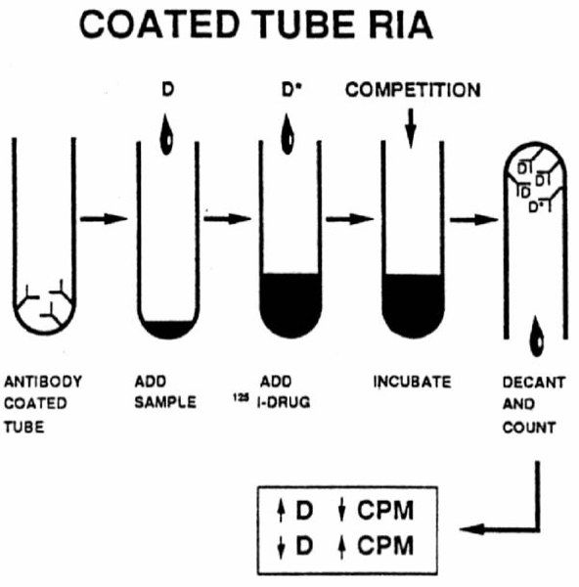
Types of Immunoassays
Within the categories of competitive, noncompetitive, there are specific types, which include:
Radioimmunoassays (RIAs) utilize a radioactive label (usually ¹²⁵I, ³H or ¹⁴C), which emits radiation that can be measured with a beta or gamma counter.

Slide 6
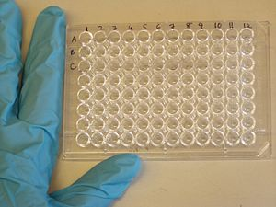
Types of Immunoassays Cont’d
In Enzyme linked immunosorbant assay (ELISA)
Reaction components are absorbed or bound to the surface of a solid phase, commonly a well of a microtiter plate
Absorbance is measured using a micro-plate reader
Sample absorbance is inversely proportional to drug concentration

Slide 7
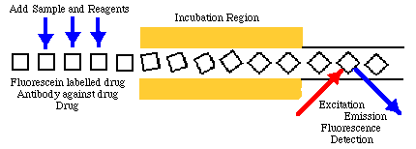
Types of Immunoassays Cont’d
In the Fluorescent Polarized Immunoassay, the drug in the sample competes with fluorescein-labeled drug for antibody binding sites.
Reaction mixture is excited by planepolarized light.
As the tracer returns to a lower energy state, it emits light; polarization is measured.
The polarization value of the sample is inversely proportional to analyte concentration.

Slide 8
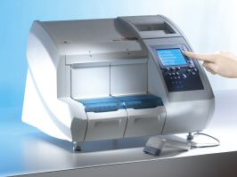
Immunoassays and Forensic Science
Forensic toxicology encompasses the determination of the presence and concentration of drugs, other xenobiotics and their metabolites in physiological fluids and organs and the interpretation of these findings as they may impact on legal issues. These include medical examiner investigations, driving under the influence and other transportation accident investigations, workplace pre-employment, random and for drug testing and judicial monitoring of arrestees and paroles.
For the most part, forensic toxicologists use of commercial immunoassays directed primarily towards abused drugs. Commercial immunoassays developed for therapeutic monitoring of other drugs, veterinary drugs and pesticides, as well as immunoassays developed in research laboratories for specialized studies, may find a role in the forensic toxicology laboratory for specialized cases.

Slide 9
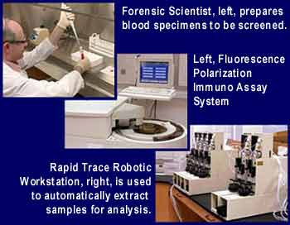
Immunoassays and Forensic Science Cont’d
While most commercial immunoassays have been developed for a urine matrix, they have been applied by forensic toxicologists to other matrices, including blood, hair, saliva, sweat, tissue homogenates, blood stains and most other physiological samples that may be of value in the investigation. The nonurine matrix usually is much more complex in its composition. Sample pretreatments that range from simple deproteinations to multistep extractions to remove matrix components and/or concentrate the sample are often required.

Slide 10
ELISA
Enzyme Linked Immunosorbent Assay

Slide 11
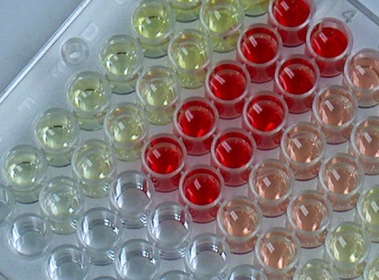
What is ELISA?
• Technique used to detect (assay) specific molecules (e.g. proteins & carbohydrates) in samples.
• Immunological technique: uses antibodies.
• Quantitative.
• Very sensitive.
• Commonly used in medicine and scientific research.

Slide 12
Basic steps of ELISA
Enzyme Linked Immunosorbent Assay
1. Antigen of interest is absorbed on to plastic surface (‘sorbent’).
2. Antigen is recognised by specific antibody (‘immuno’).
3. This antibody is recognised by second antibody (‘immuno’) which has enzyme attached (‘enzyme-linked’).
4. Substrate reacts with enzyme to produce product, usually coloured.
Coloured product = measure (assay) of antigen present

Slide 13
Secondary antibody
Substrate
Enzyme
Coloured
product
Primary antibody
Different antigens in sample

Slide 14
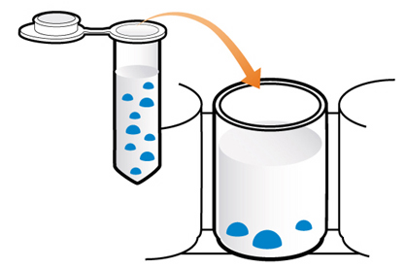
Coating the wells
Prepare the appropriate concentrations of the immunogen.
● Using pastettes, transfer 100μL of the appropriate extract into microwells:
1. PBS only
2. low concentration
3. medium concentration
4. high concentration
● Leave on bench (or at 37°C) for appropriate time to allow samples to absorb on to plastic surface.

Slide 15
Wash wells of excess sample
● Using pipette, fill wells with PBS-Tween then empty out.
● Tap wells upside down on paper towel.
Repeat twice more, making sure no liquid remains after the last wash.
Block with BSA
● Label the pipette PBST and keep for later PBST pipetting.

Slide 16
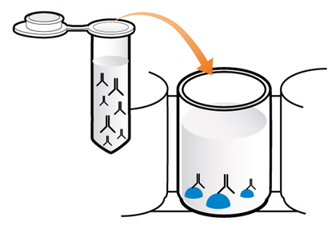
Add primary antibody
● Using a clean pastette, add 100μL of primary antibody (mouse monoclonal) to each well.
● Leave on bench (or at 37°C) for appropriate time.

Slide 17
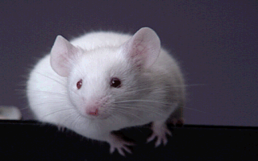
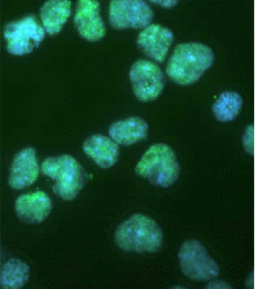
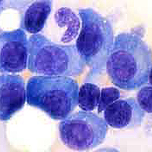
Monoclonal antibody production
(hybridoma technology)
Inject
mouse with antigen
Obtain
Mouse spleen
B-lymphocytes
Grow mouse myeloma (tumour) cells in culture
Fuse
B-lymphocytes with myeloma cells
Antibody-producing hybridoma cells

Slide 18
B-lymphocyte and myeloma mixture
Unlimited supply
of antibody specific for single epitope
Keep clone producing antibody which best detects antigen
Select fused
and reproducing hybridoma cells
via growth medium
?
Make clones from individual antibody-producing cells
Screen hybridomas
for antibody production

Slide 19
Wash wells of excess primary antibody
● Empty out contents of wells into waste container.
● Using pipette, fill wells with PBST then empty out.
● Tap wells upside down on paper towel.
● Repeat twice more, making sure no liquid remains after the last wash.

Slide 20
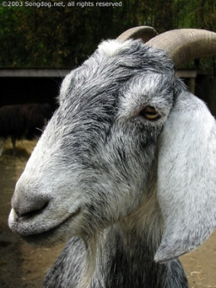
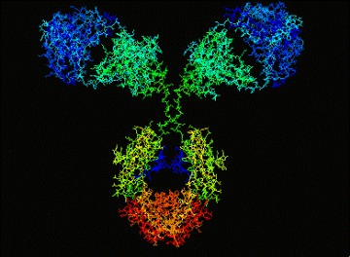
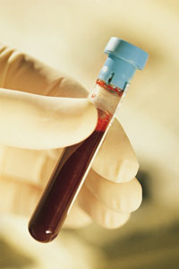
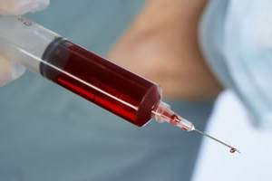
Secondary antibody production
Mouse serum injected into a different species, e.g. rabbit, goat.
Polyclonal antibodies which can recognise any mouse antibody
Animal makes various antibodies against the different antigens in serum
Select anti-mouse antibodies from plasma
Take blood from animal

Slide 21
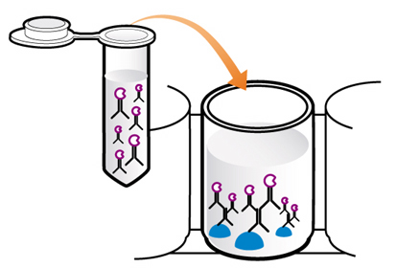
Add secondary antibody
● Conjugated to the enzyme horseradish peroxidase.
● Using a clean pastette, add 100μL of secondary antibody (anti-mouse polyclonal) to each well.
● Leave on bench for appropriate time.

Slide 22
Enzymes used in ELISA
Peroxidase from horseradish
Alkaline phosphatase from E. coli
β-galactosidase from E. coli

Slide 23
Wash wells of excess secondary antibody
● Empty out contents of wells into waste container.
● Using pipette, fill wells with PBST then empty out.
● Tap wells upside down on paper towel.
● Repeat twice more, making sure no liquid remains after the last wash.

Slide 24
● React with a colourless substrate to produce a coloured product.
● Must work fast at room temperature so the colour develops quickly.
● Have minimal interference from factors in sample.

Slide 25
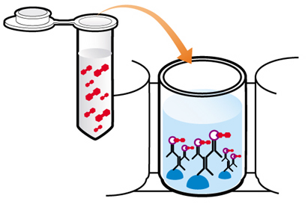
Add substrate for enzyme
● Wearing gloves, and
using a clean pastette, add 100μL of tetramethyl benzidine (TMB) to each well.
● Observe colour development (blue product formed) and compare with colour chart.
● Intensity of colour indicates amount of antigen present in sample.

Slide 26
8. Observe colour development
7. Add substrate for enzyme
1. Add antigen
2. Wash with PBST
6. Wash with PBST
4. Wash with PBST
3. Add primary antibody
5. Add secondary antibody

Slide 27
Uses of ELISA
• Disease detection in people, animals and plants (e.g. HIV in humans).
• Detection of allergens in food, e.g. peanuts.
• Detection of illegal drugs in humans.
• Detection of hormones, e.g. pregnancy testing kits.

Slide 28
Advanced Higher Biology Investigation ideas
● Detection of Botrytis (as an antigen) in fruit and vegetables from market or garden.
● Quantification of Botrytis as infection develops.
● Detection of Botrytis in tissue before symptoms are observed.
● Investigation on effect of temperature on rate of Botrytis development.
Notes:
Following this slide, ask teachers if they’ve used this kit before and if they have any comments.

