Slide 1
Microfluidic

Slide 2
Introduction
In the last decade, microfluidic devices have received much attention due to their competitive advantages, especially in regards to reduced sample and reagent consumption, analysis time and increased automation.
Microfabrication technology was started more than three decades ago.
1979 : An integrated gas chromatograph was fabricated on a 2-inch (5-cm) silicon wafer.

Slide 3
Introduction cont,…
During the past decade, array technologies and microfluidics have become commercially available in biochips for genomics and proteomics.
The structures used in microfluidic and in Lab-on-a-Chip devices are not nanostructures, but are in the micrometer to even millimeter range.

Slide 4
Bionanotechnology requires a microfluidic platform technology as an interface to the macro world : for self-assembled monolayers; for the handling of nanoparticles, cells or nanobarcods; and to monitor and control cellular machinery.
Nanobiotechnology will enable novel microfluidic platforms due to the integration of nanostructures, nanocoatings by the integration of nanoporous membranes, and by integrating detection and measurement techniques such as nanoelectrodes, nanooptics, and patch-clamp arrays.

Slide 5
Definition and History
A microfluidic chip is defined as an assembly of microstructures on a common substrate, used for the manipulation of fluids (gases and/or liquids).
Microfluidics encompasses the study of fluid movement, usually as a liquid, through 10-1000 micron channels, for a sense of scale, consider that a micron is 100 times smaller than the diameter of a human hair.

Slide 6
Definition and History cont…
The miniaturization of fluid processing (as found in medicine and environmental testing) into a convenient lab-on-a-chip (LOC) promises the rapid and routine deployment, in the field, of previously big lab-bound processing techniques.
At such small scales the fluid in microfluidic devices is dominated by laminar viscosity and surface tension effects.

Slide 7
Laminar flow is characterized by a smooth boundary-conforming fluid, unlike turbulent flow which exhibits chaotic eddies and recirculation zones.
The Reynolds number is an indicator of whether a fluid is likely to encounter laminar or turbulent flow and it is proportional to a characteristic length such as channel width. The tiny scales of microfluidic devices ensure that the Reynolds number is low and therefore all flow is laminar.

Slide 8
A Lab-on-a-Chip is a combination and integration of fluidic elements, sensor components and detection elements to perform the complete sequence of a chemical reaction or analysis, including:
sample preparation,
reactions,
separation,
detection.

Slide 9
Among the first examples were a gas chromatograph at Stanford University.
The inkjet print-head has become one of the commercially most successful fluidic applications of this new technology, which was called ‘’MEMS’’ (Micro Electro Mechanical Systems) in the U. S. and “MST” (Microsystem Technology) in Europe.
Many discrete microfluidic devices, such as microvalves, micropumps, flow sensors, and chemical and biological sensors were developed , but the benefits of miniaturization are best taken advantage of when devices are integrated into a fluidic system.

Slide 10
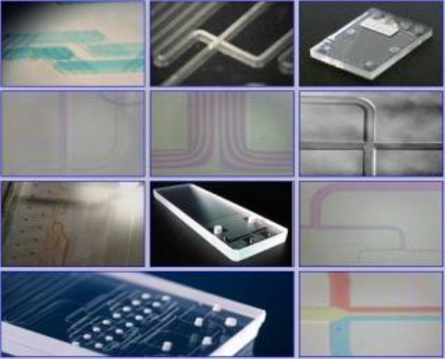
Microfluidic Devices

Slide 11
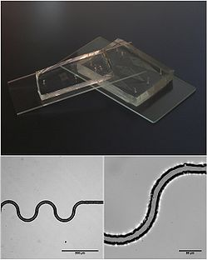
Silicone, rubber and glass microfluidic devices. Top: a photograph of the devices.
Bottom: differential interference contrast (DIC) micrographs of a serpentine channel ~15 μm wide.

Slide 12
Advantages of Microfluidic Devices
Microfluidics offer advantages both from a technical as well as from an economical viewpoint.
When the dimension of fluidic structures are scaled down to the micrometer region, the surface to volume ratio of the fluidic involved increases dramatically, and surface effects start to dominate volume effects.
For the fluid flow in microstructures this leads to well-defined flow characteristics, as the flow is strictly laminar and turbulence can only appear in very limited regions around sharp edges.

Slide 13
Due to the absence of reasonable turbulence, mixing of different fluids can only be achieved by diffusion, or by specially designed fluidic mixing elements.
Moreover, due to the scaling factors of diffusion and heat conduction, the equilibrium conditions can be reached faster.

Slide 15
The small volumes involved are of enormous advantage especially for highly parallel applications, like array devices used in genomics, proteomics, and drug delivery.
The reduction in the amount of substance required for each reaction leads to significant cost reduction for these types of applications.
Another advantage is that minimally invasive methods are sufficient for taking samples.

Slide 16
Another method to define precisely small fluid volumes is droplet generation, this is a separate application field of microfluidics, with important products such as inkjet print-heads or drug delivery systems.
Array spotters are another product of this kind, used in the immobilization process of nucleic acids, antibodies, etc.
The large surface implies a high reaction efficiency, as the surface areas which may be coated with catalysts or enzymes are large compared to the reaction volume.
Due to the large surface to volume ratio, capillary forces dominate volume factors such as gravity.

Slide 17
Concepts for Microfluidic Devices
Two main organization principles are used in integrating the fluidic elements on the chip.
Parallelization
Sequential integration
Parallelization
This is used when the same type of reaction has to be performed in parallel many times.
Examples are array type of chips found in DNA, carbohydrate analysis, proteomics.

Slide 18
Parallelization can lead to dramatic cost advantages in three ways:
The manufacturing cost for a device with many integrated reaction wells is much lower than that of many devices for just one reaction.
All reactions are performed in parallel, saving time
Parallel reactions are an ideal input for laboratory automation and information processing of the assay results.
One very basic application of the parallelization principle are nanotiterplates, an extension of the well-established micro plate technology into the nanoliter region.

Slide 19
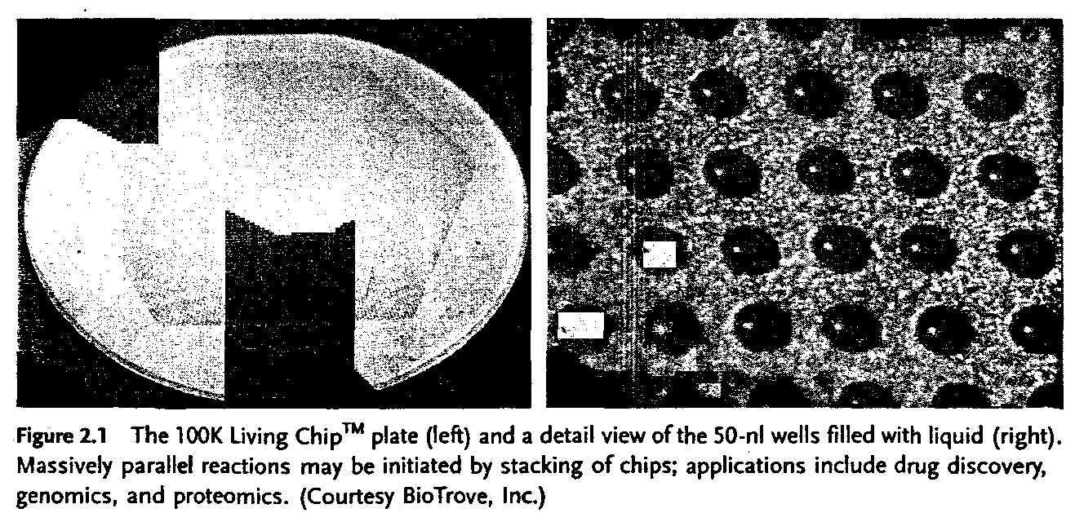
As an example of parallelization, an array of 250μm × 250 μm wide, 500 μm deep, bottomless wells.
One chip will carry up to l00000 of these reaction wells

Slide 20
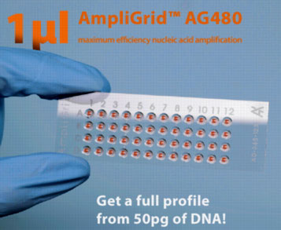
Commercial Systems
Advalytix
1 µl PCR slides for forensic

Slide 21
Sequential integration
Here, several fluidic structures, each designed to perform one step in a processing sequence, are integrated one substrate and interconnected by channel network to provide the transport of the fluids between the processing steps.
The fluids will pass the processing steps in a sequential manner.
The fluidic structures involved are channels, mixers, reaction chambers, detection chambers, sample and waste reservoirs, microvalves, micropumps, microsensors, heating zons,..

Slide 22
In many cases, complete fluidic components, for example micropumps, are added as separate components to the microfluidic device
One important example of sequential organization is that of micro Total Analysis Systems (μTAS).

Slide 23
µTAS (micro total analysis system)
An integrated system that performs all steps in an analysis — that is, sampling, sample
pre-treatment, sample transport, chemical reactions, analyte separation, product
isolation and detection in a microfluidic chip. First defined in 1990, μTAS emphasizes
the analytical function of a microfluidic chip.

Slide 24
A first, application was an integrated system to monitor the glucose content in a fermentation process.
Another very important application for microfluidic devices are PCR.

Slide 25
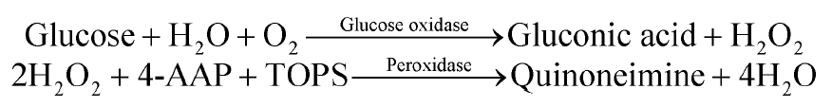
Lab-on-a-Chip an Example
Reaction
Protocol
Metering of sample
Mixing of sample and reagents
Optical detection
Detection principle
Absorption at 545 nm
Acetyl Acetone Peroxide

Slide 26
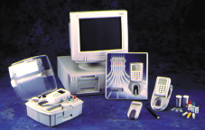
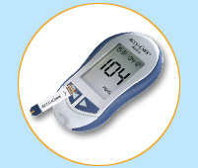

Commercial Systems: Glucose detection
Roche; AccuCheck
Glucose in blood
Lifescan;
Glucose monitor

Slide 27
The sequential organization scheme is also represented by capillary electrophoresis chips.
Some microfluidic devices combine both organizational principles.

Slide 28
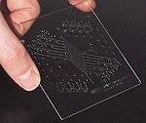
Commercial Systems
Aclara Biosciences
Product: Labcard
(Electrophoresis)

Slide 29
Array-type fluidic chips will, in most cases, require a channel network for fluid transport, and more complex reaction sequences require more than one reaction site.

Slide 30
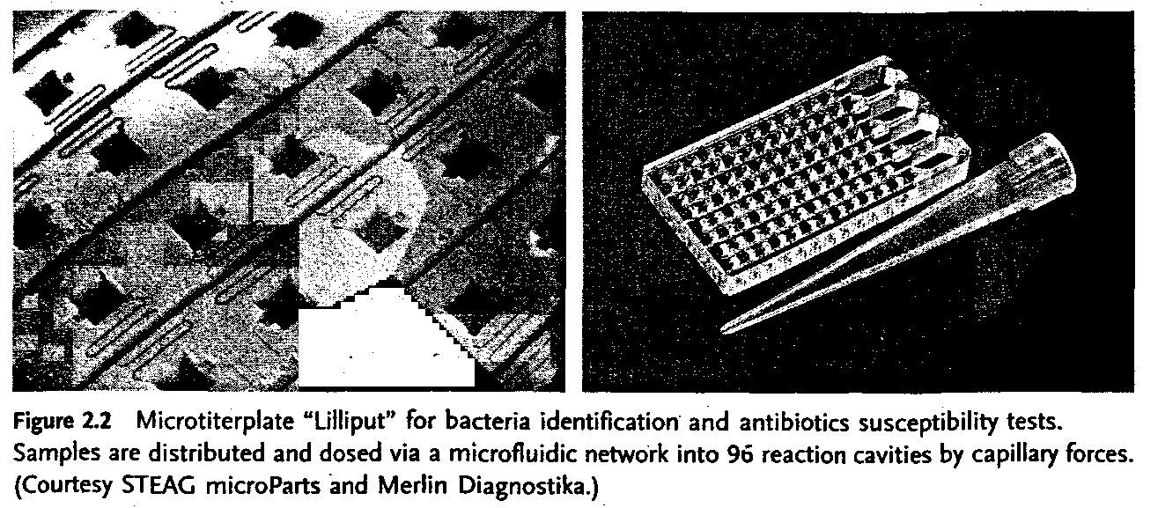
A combination of 96 wells , together with a fluid distribution network , on a single chip is shown in figure below:

Slide 31
In most cases it is favorable to include parallel processing in sequential arrangements.

Slide 32
Fluid Transport
One important aspect of microfluidic devices is the fluidic transport. One or several fluids must be transported to reaction sites, and often a sequence of transport actions at defined times is required. Two types of mechanisms are used:
In actively driven transport, active fluidic elements such as pumps and valves are used to achieve the transport. These may be external elements, but in some cases they are part of the fluidic device, either by adding them as discrete elements or by integrating them in to the fluidic device.

Slide 33
Whitesides. NATURE|Vol 442|27 July 2006

Slide 34
These active devices require an outside energy supply to operate and this can be electrical, mechanical,..
This may require an electrical network to be part of the fluidic system.
In one example (the Mixed Circuit Board (MCB) concept) , printed circuit boards have been chosen as the basis for the fluidic device, carrying both the fluid microchannels as well as the electrical network.
The drive elements could be placed on a separate drive plate which is attached to the fluidic chip by clamping during the operation.
In this case the fluidic chip could be a single use , disposable device, while the more expensive drive plate would be re-usable.

Slide 35
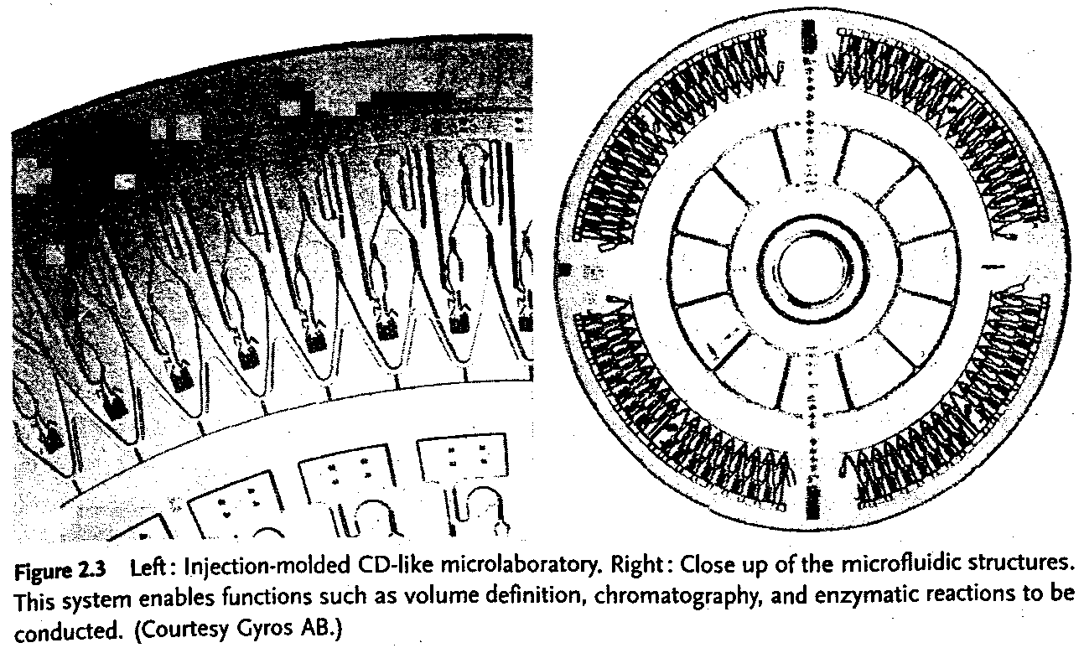
Another means of actively providing fluidic transport is the use of mechanical forces.
In the case of centrifugal forces, the fluidic structures are usually on a CD-like substrate, which is placed on a spinning device which resembles a laboratory centrifuge.
The fluidic transport can be triggered by correct selection of rotational speed, position on the substrate and channel width.
Commercially available platforms include the ‘ Lab CD’ and the ‘ Gyrolab microlaboratory’

Slide 37
A major advantage of microfluidics is that fluidic transport can also be achieved in a passive manner.
In this case capillary forces are used to transport the fluid to the reaction sites. Capillary forces can be large compared to volume forces in microfluidics.
By correct design of the fluidic structures the flow front in the device can be controlled and this allows the transport times and volumes of the fluids transported to be set to desired values.

